Slide 1


Multi’omic analysis of subtype evolution and heterogeneity in high-grade serous ovarian carcinoma Universitat Pompeu Fabra Barcelona March 3, 2020
Levi Waldron
City University of New York
Graduate School of Public Health and Health Policy
@leviwaldron1
NCI: 1 R03 CA191447 Validation and clinical relevance of ovarian cancer molecular subtypes
NCI ITCR: 2 U24 CA180996 Cancer genomics: integrative and scalable solutions in R/Bioconductor

Slide 2
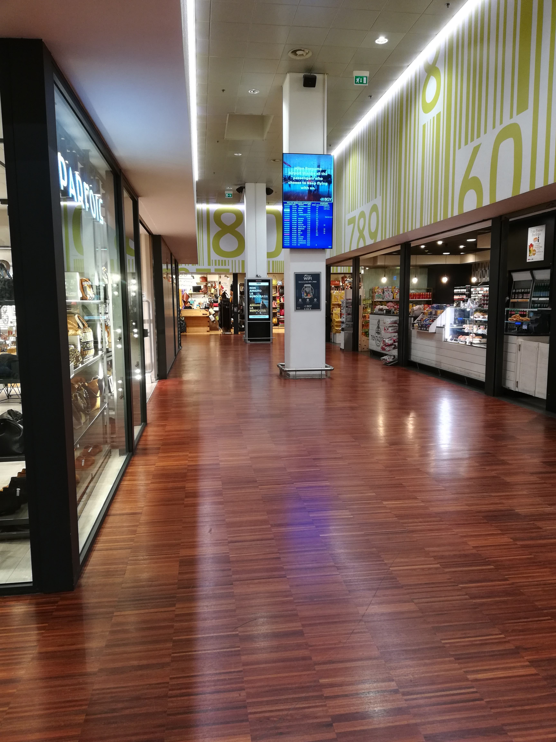
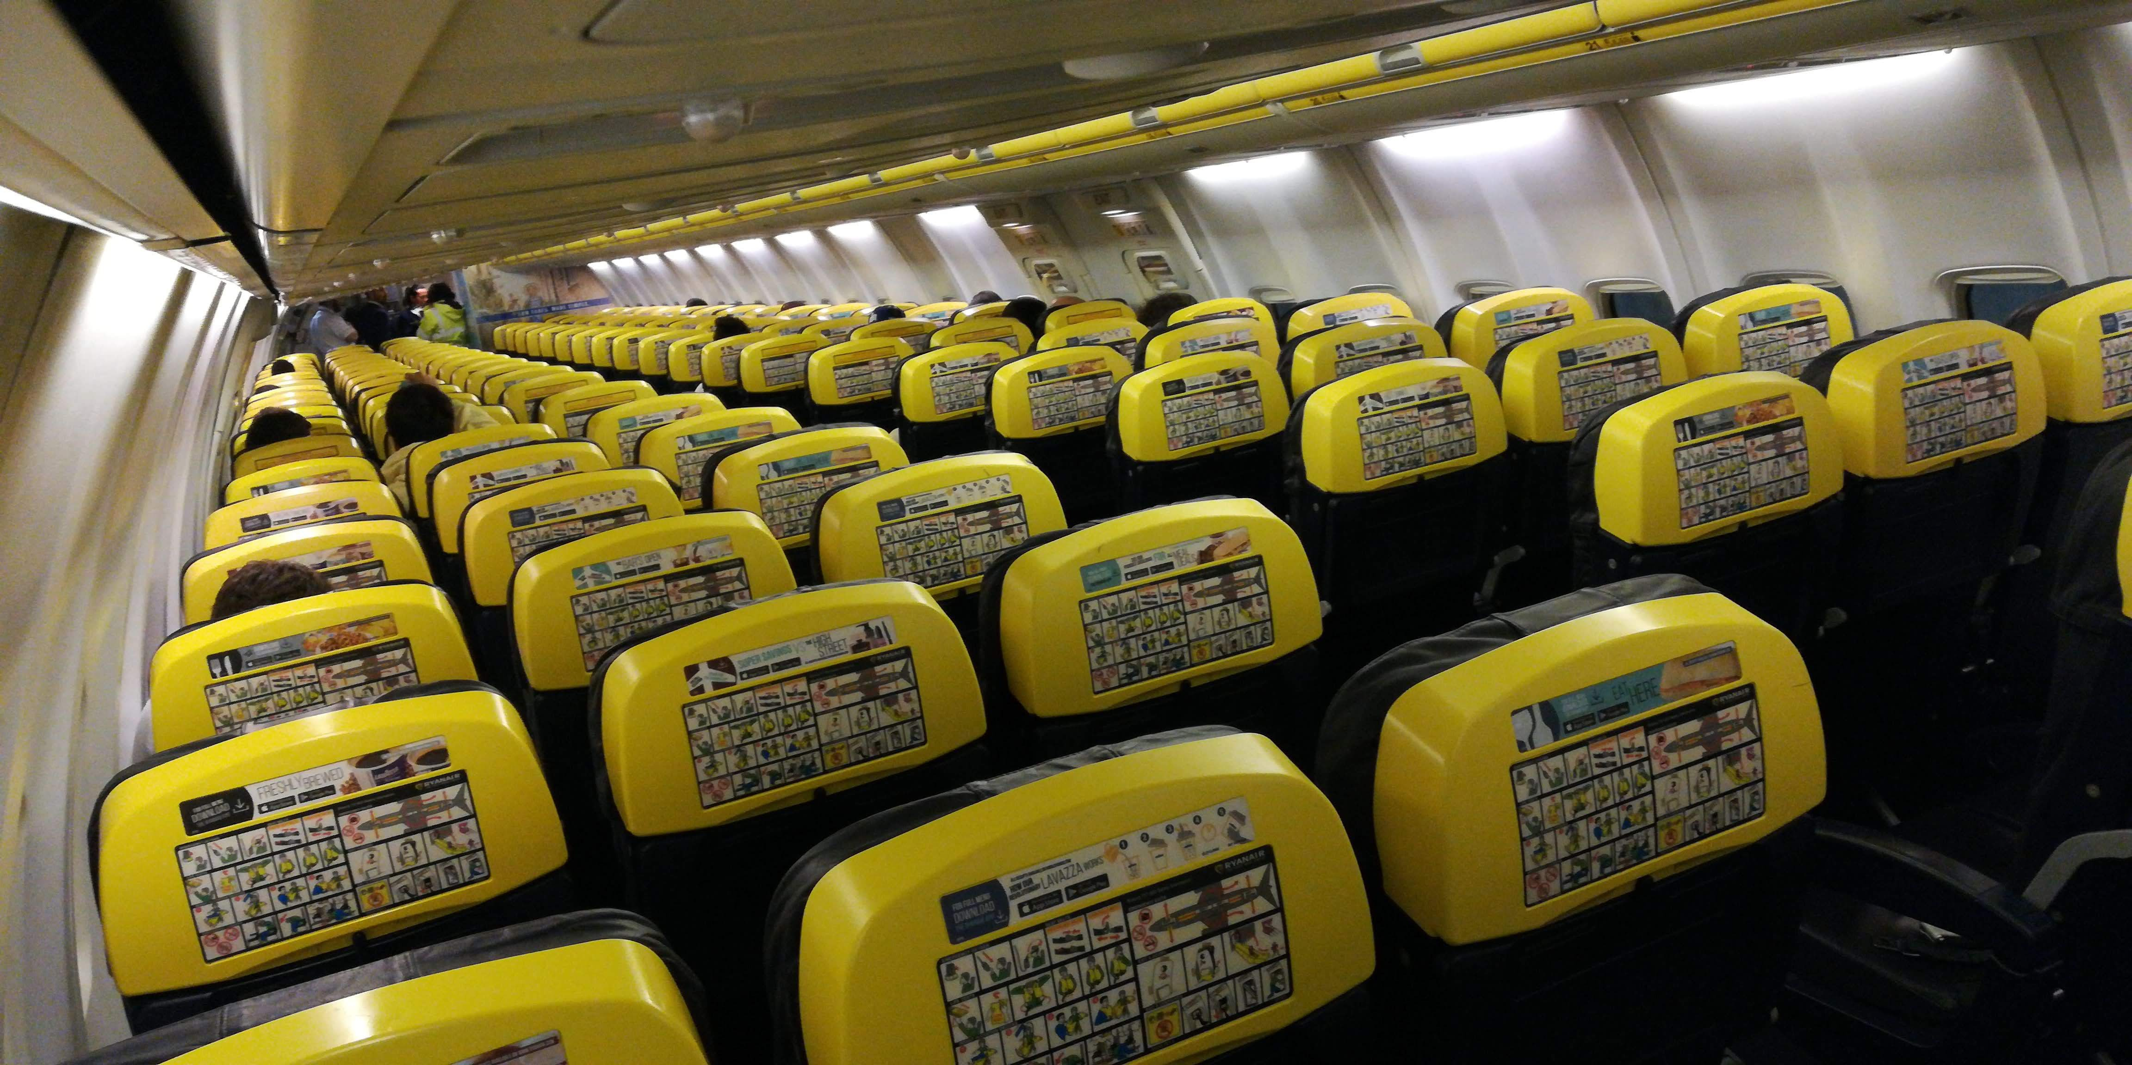
Travel from Italy during Coronavirus
RyanAir BGY - BCE
Milan - Bergamot Airport

Slide 3
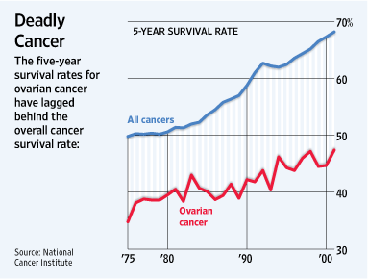
Limited progress in survival of patients with ovarian cancer
22,000 new cases each year
14,400 women die each year
Majority late-stage, high-grade, serous carcinoma
Notes:
Ovarian cancer is a major cause of mortality, and improvements in prognosis have lagged other cancers. One reason for this is that a majority of patients present with late-stage, high-grade, serous histology – this is a high-risk group with <50% 5-year survival, with little available from a clinical perspective to further refine prognosis.
Current 2020 5-year survival “All SEER stages combined” for patients diagnosed 2009 – 2015 (https://www.cancer.org/cancer/ovarian-cancer/detection-diagnosis-staging/survival-rates.html): 47%

Slide 4
Attempts to simplify a complex disease using tools of genomics
Two historical approaches:
Supervised classifiers
Predictors of survival or surgical outcomes
Unsupervised classifiers
Hierarchical clustering

Slide 5
Approach 1: Supervised classification
Model | Reproducibility
 | Model Provided | Training Data Available | Validation Data Available | Verified Implementation
TCGA11 [12] | YES | YES | YES | YES
Denkert09 [13] | YES | YES | YES | YES
Bonome08_263genes [14] | YES | YES | YES | YES
Bonome08_572genes [14] | YES | YES | YES | YES
Mok09 [15] | NO | YES | YES | PARTIALLY
Yoshihara12 [16] | YES | - | YES | YES
Yoshihara10 [17] | YES | - | YES | YES
Bentink12 [18] | YES | - | YES | YES
Kang12 [19] | YES | YES | YES | PARTIALLY
Crijns09 [20] | NO | YES | NO | NO
Kernagis12 [21] | PARTIALLY | YES | YES | PARTIALLY
Sabatier11 [22] | PARTIALLY | NO | NO | NO
Konstantinopoulos10 [23] | YES | - | YES | PARTIALLY
Hernandez10 [24] | PARTIALLY | - | YES | PARTIALLY
Reproducibility of 14 published models for prognosis of HGSOC
Waldron L et al.: Comparative meta-analysis of prognostic gene signatures for late-stage ovarian cancer. J. Natl. Cancer Inst. 2014, 106.

Slide 6
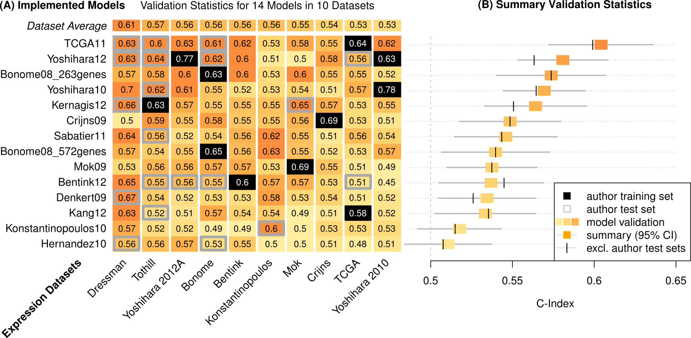
Approach 1: Supervised classification
Validation Statistics:
14 Models in 10 Datasets
14 prognostic signatures
10 microarray datasets
Waldron L et al: Comparative meta-analysis of prognostic gene signatures for late-stage ovarian cancer. J. Natl. Cancer Inst. 2014, 106.
Notes:
We used a standard meta-analysis approach to summarize the performance of each model across all non-training datasets, shown here with 95% confidence intervals. The vertical hashes show how the summary estimate changes if you exclude validation datasets used by the signature’s authors for validation, which is an interesting story that I won’t get into.
Meta-analysis uses a standard fixed-effects model, which is just a weighted average of the C-Index from each study, weighted by the size of the confidence interval in each study. Fixed-effects assumption of homogeneity was not violated.

Slide 7
Approach 2: Unsupervised classification
library(curatedOvarianData)
data(GSE12418_eset)
x <- exprs(GSE18520_eset)
colnames(x) <- GSE18520_eset$sample_type
d <- as.dist(1 - cor(x))
plot(hclust(d))
Ganzfried B et al.: curatedOvarianData: clinically annotated data for the ovarian cancer transcriptome. Database 2013, 2013:bat013.

Slide 8
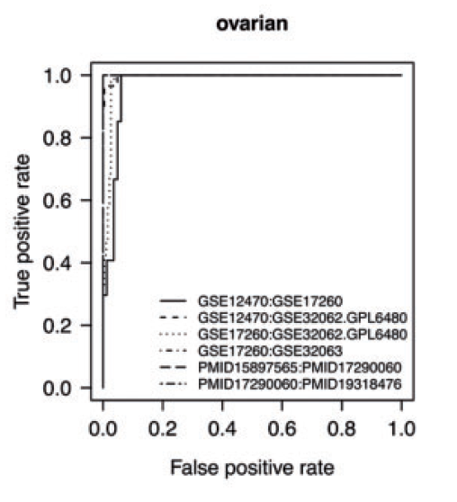
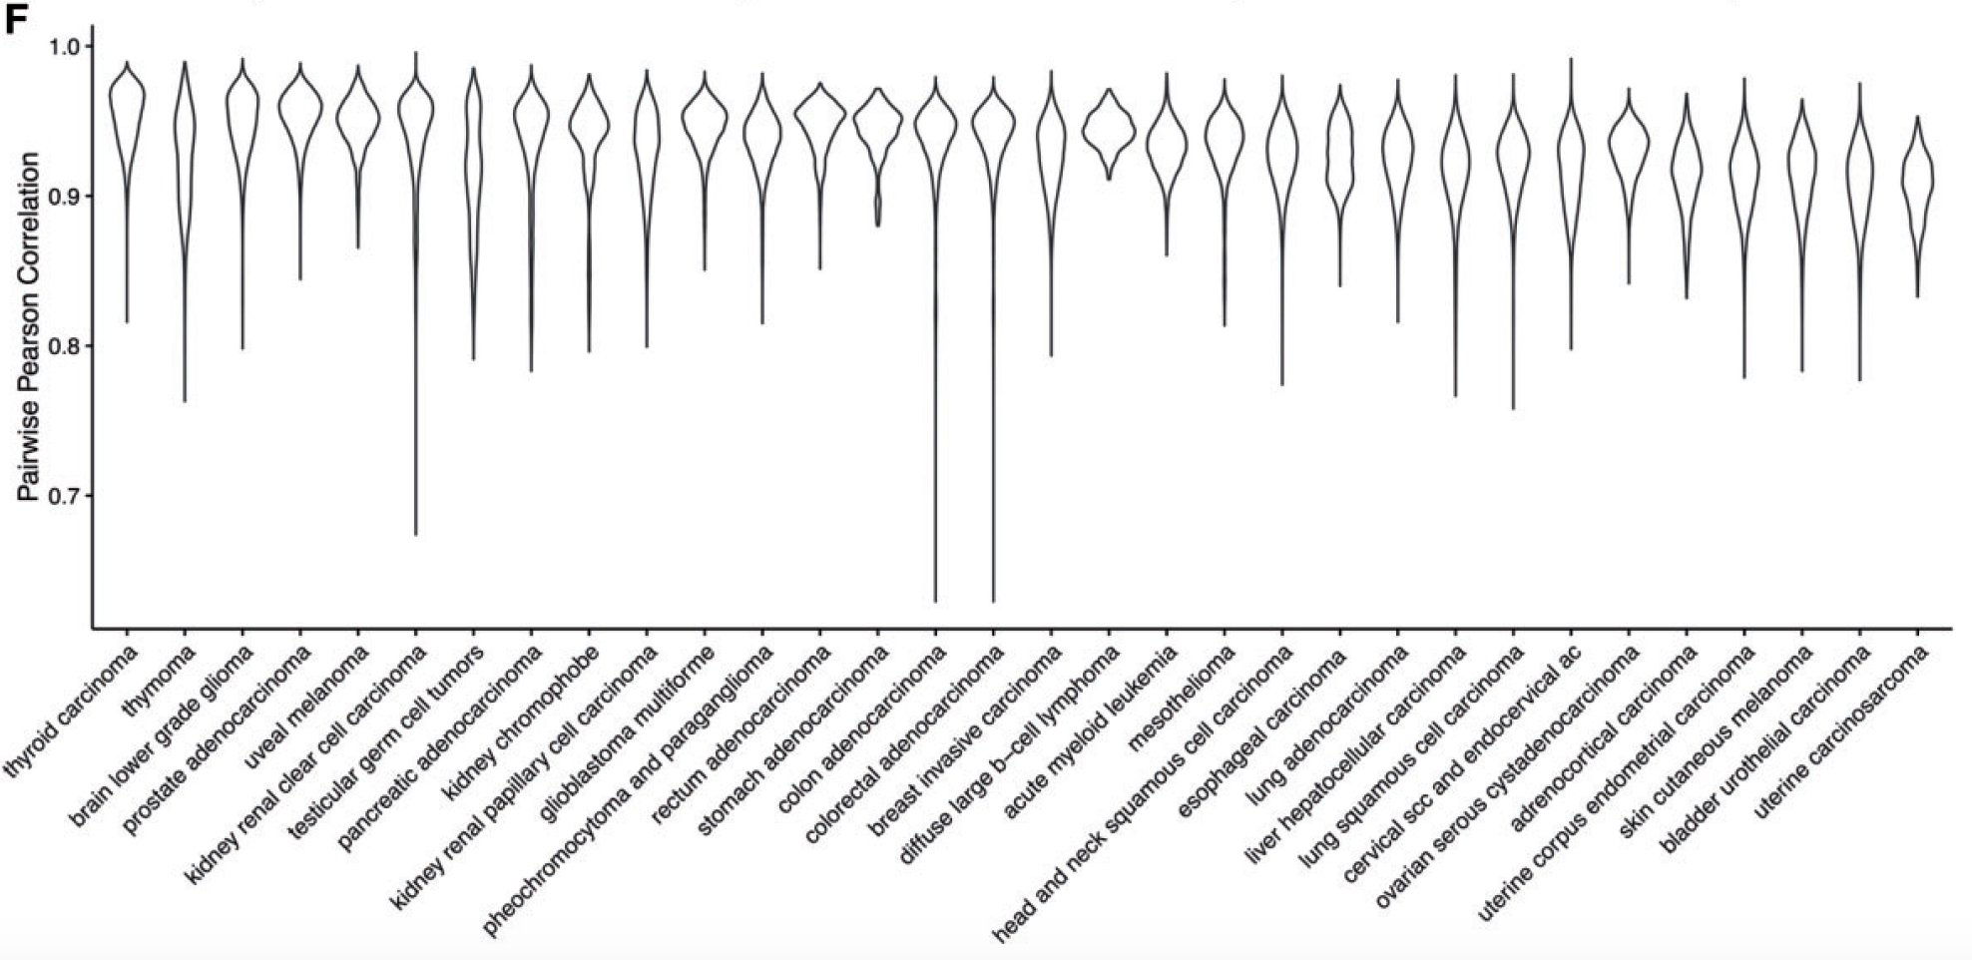
OVC has diverse gene expression profiles
Waldron L et al.: The Doppelgänger Effect: Hidden Duplicates in Databases of Transcriptome Profiles. J. Natl. Cancer Inst. 2016, 108.

Slide 9
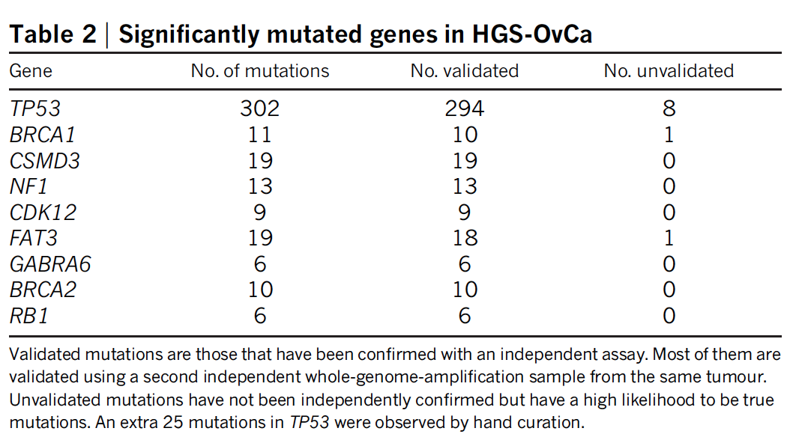
Genomic characteristics of OVC
TP53 mutations in almost all tumors
Low prevalence of mutation in any other gene
>100 recurrent focal DNA copy number alterations
Highly distinctive individual gene expression profiles, broadly different from normal profiles
Cancer Genome Atlas Research Network: Integrated genomic analyses of ovarian carcinoma. Nature 2011, 474:609–615.

Slide 10
The appeal of distinct subtypes
Six subtypes proposed in 2008¹
Four subtypes somewhat confirmed by follow-up studies [2-5]:
Differentiated, mesenchymal, immunoreactive, proliferative
[1] Tothill RW et al.: Novel molecular subtypes of serous and endometrioid ovarian cancer linked to clinical outcome. Clin. Cancer Res. 2008, 14:5198–5208.
[2] Cancer Genome Atlas Research Network: Integrated genomic analyses of ovarian carcinoma. Nature 2011, 474:609–615.
[3] Konecny GE et al.: Prognostic and therapeutic relevance of molecular subtypes in high-grade serous ovarian cancer. J. Natl. Cancer Inst. 2014, 106.
[4] Helland Å: Deregulation of MYCN, LIN28B and LET7 in a molecular subtype of aggressive high-grade serous ovarian cancers. PLoS One 2011, 6:e18064.
[5] Verhaak RGW et al.: Prognostically relevant gene signatures of high-grade serous ovarian carcinoma. J. Clin. Invest. 2012, 123:517–525.

Slide 11
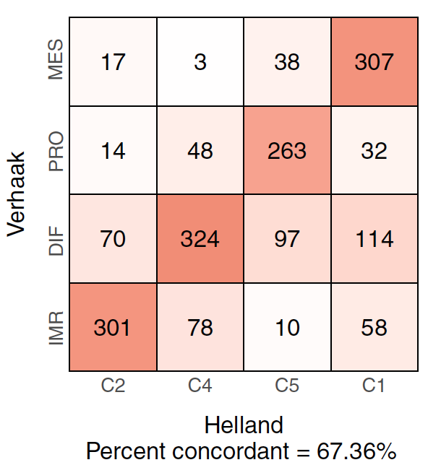
But, there are problems
Concordance between subtype classifiers is not great
Chen et al: Consensus on Molecular Subtypes of High-grade Serous Ovarian Carcinoma. Clin. Cancer Res. 2018:clincanres.0784.2018.

Slide 12
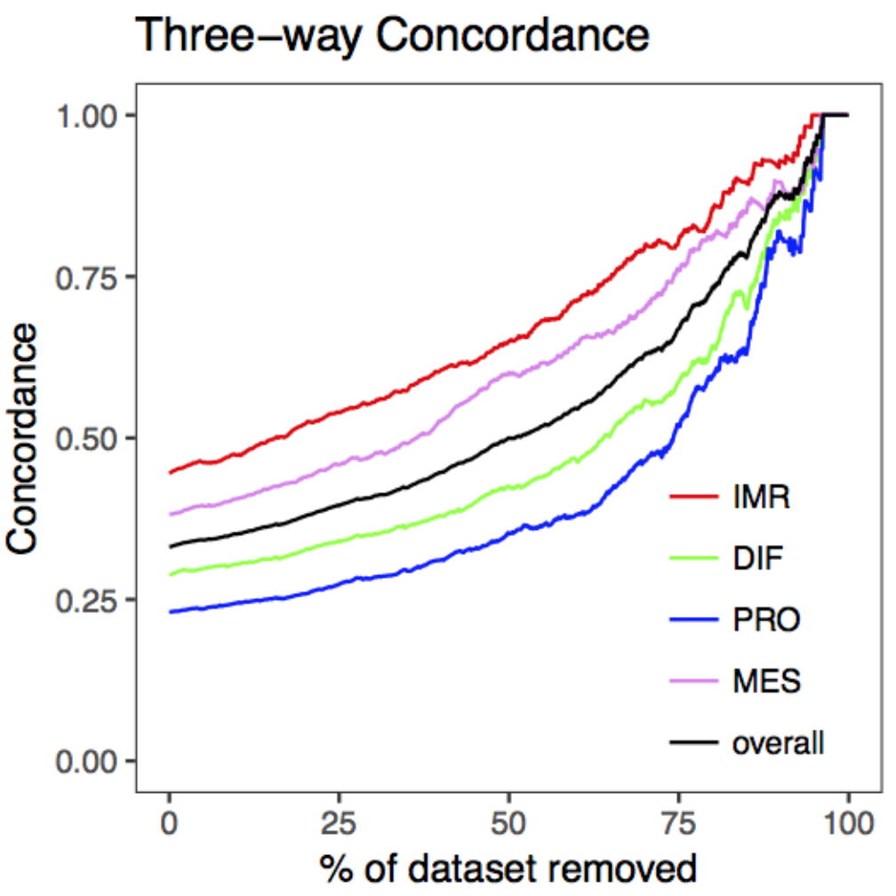
Concordance between 3 classifiers of high-grade serous ovarian carcinoma
Tumors confidently called by all three classifiers.
High concordance for <20% of tumors
All tumors
Low replicability between classifiers of different groups
Chen et al: Consensus on Molecular Subtypes of High-grade Serous Ovarian Carcinoma. Clin. Cancer Res. 2018:clincanres.0784.2018.

Slide 13
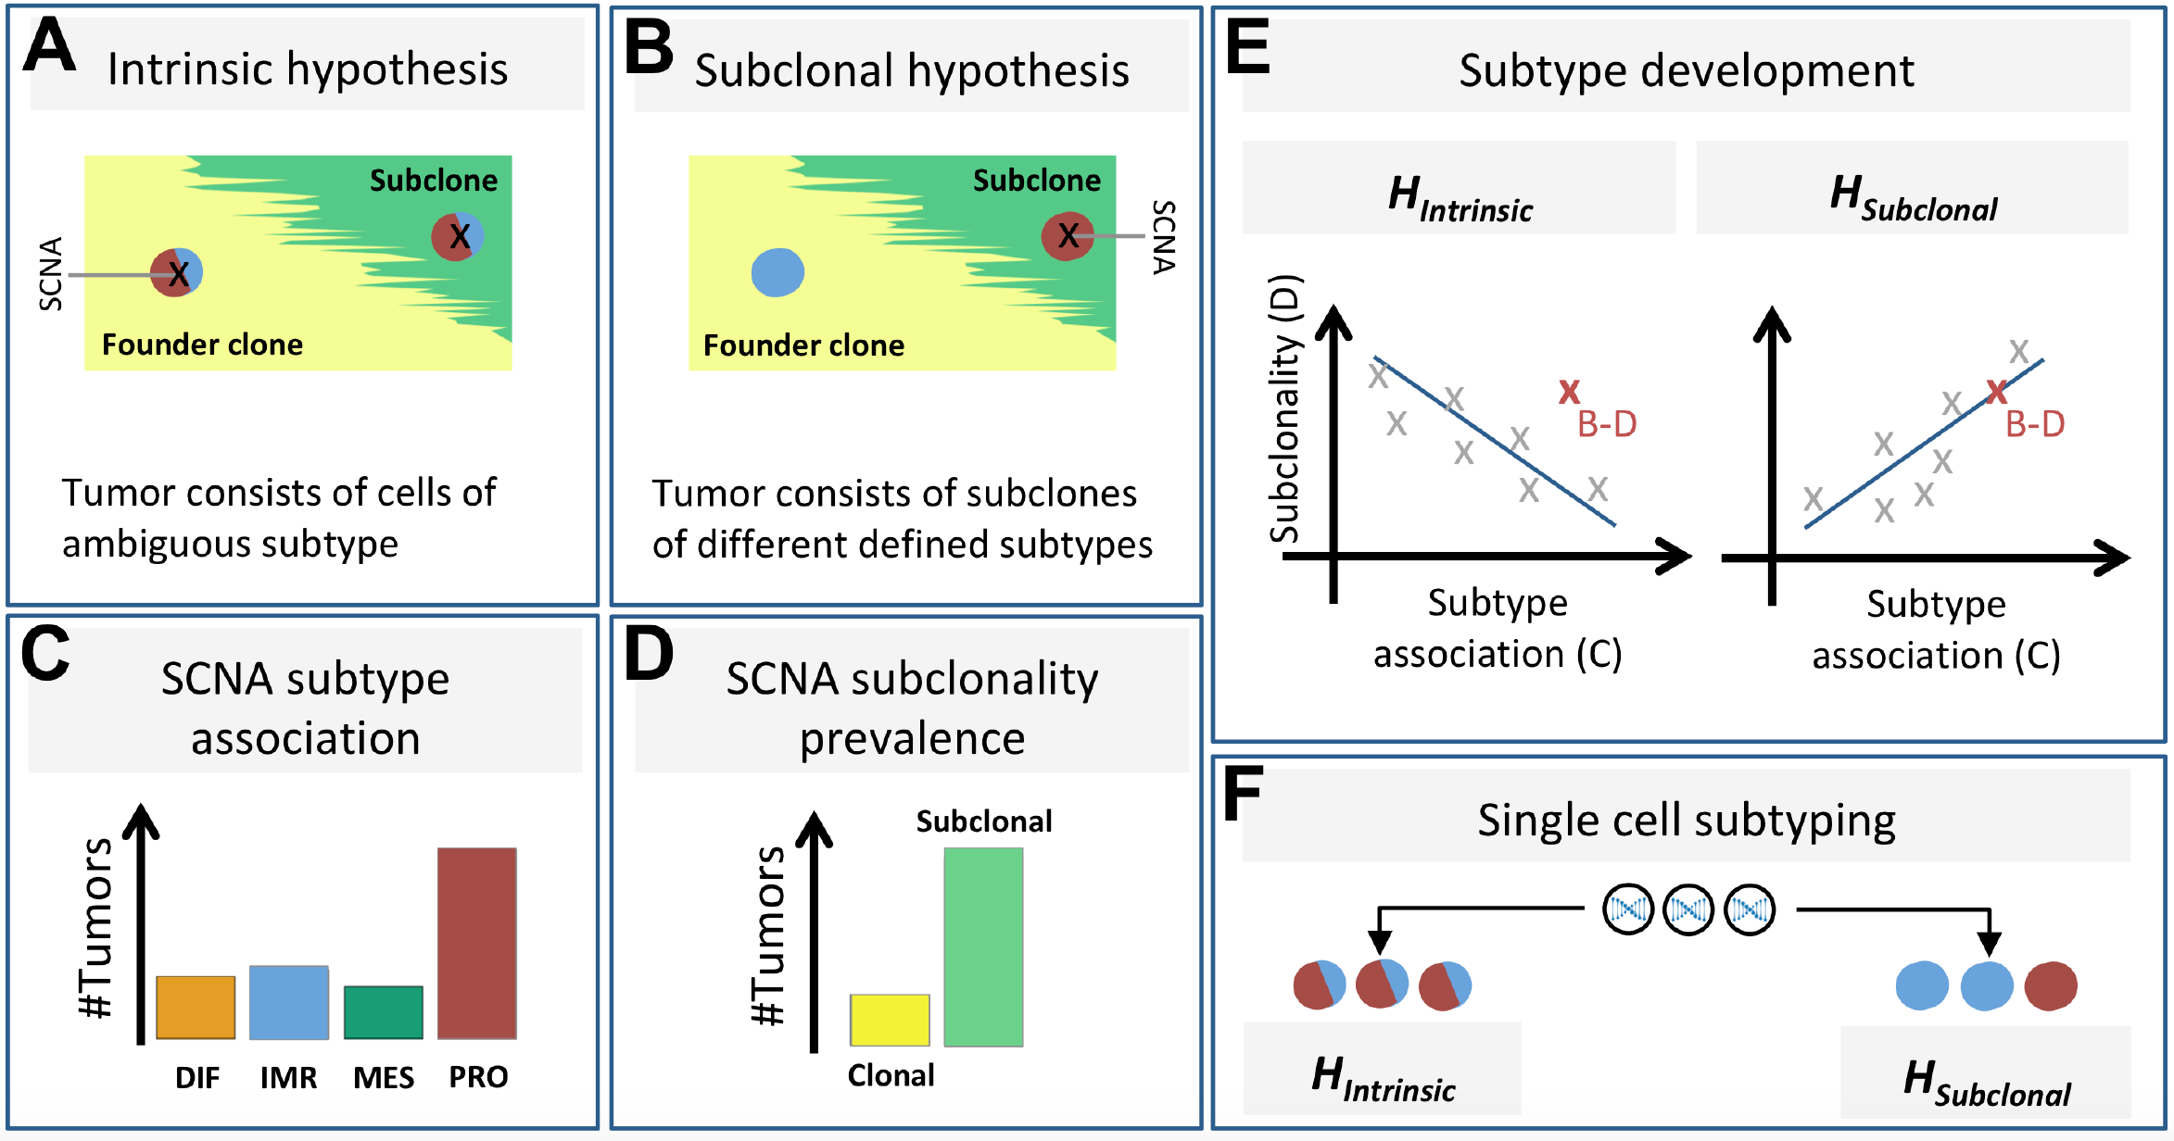
Questions:
Ludwig Geistlinger
Sehyun Oh
Does subtype differentiation occur early or late in carcinogenesis?
Different subtypes between clones in a tumor?
Can we answer this question using multi-omic analysis of bulk tumors from TCGA?
Do single cancer cells have clearer properties?
Can single-cell RNA-seq clarify the nature of OVC subtypes?
Geistlinger et al. Multi-omic analysis supports a developmental hierarchy of molecular subtypes in high-grade serous ovarian carcinoma. Submitted. https://www.biorxiv.org/content/10.1101/554394v2
Oh et al. Reliable analysis of clinical tumor-only whole exome sequencing data. JCO Clinical Cancer Investigation (In Press) https://www.biorxiv.org/content/10.1101/552711v2

Slide 14
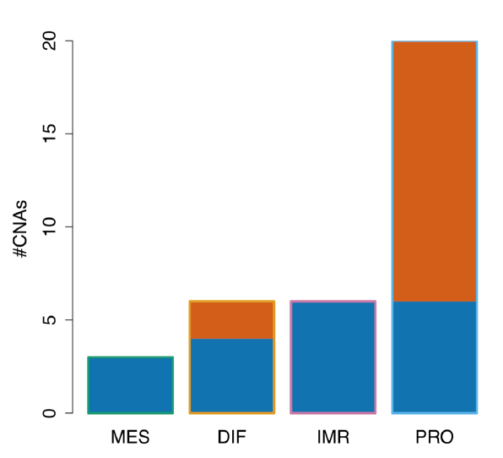
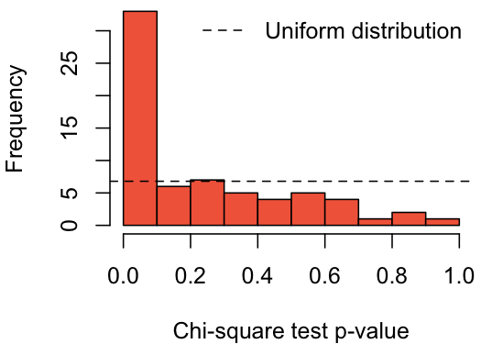

Piece #1: recurrent focal copy # alterations are associated with transcriptome subtype call

Slide 15
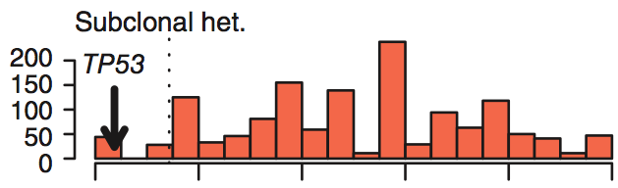
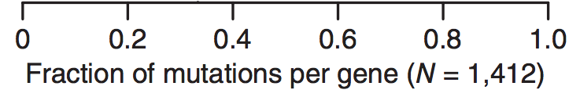
Piece #2: recurrent focal copy # alterations vary in subclonal heterogeneity
Subclonal heterogeneity of 1,412 genes as calculated and plotted by Carter et al. (Carter et al., 2012). Subclonal heterogeneity is defined as the fraction of samples in which mutations of that gene were inferred to be subclone-specific.

Slide 16
Piece #3: Are subtype-associated focal copy # alterations more, or less, sub-clonal than others?

Slide 17
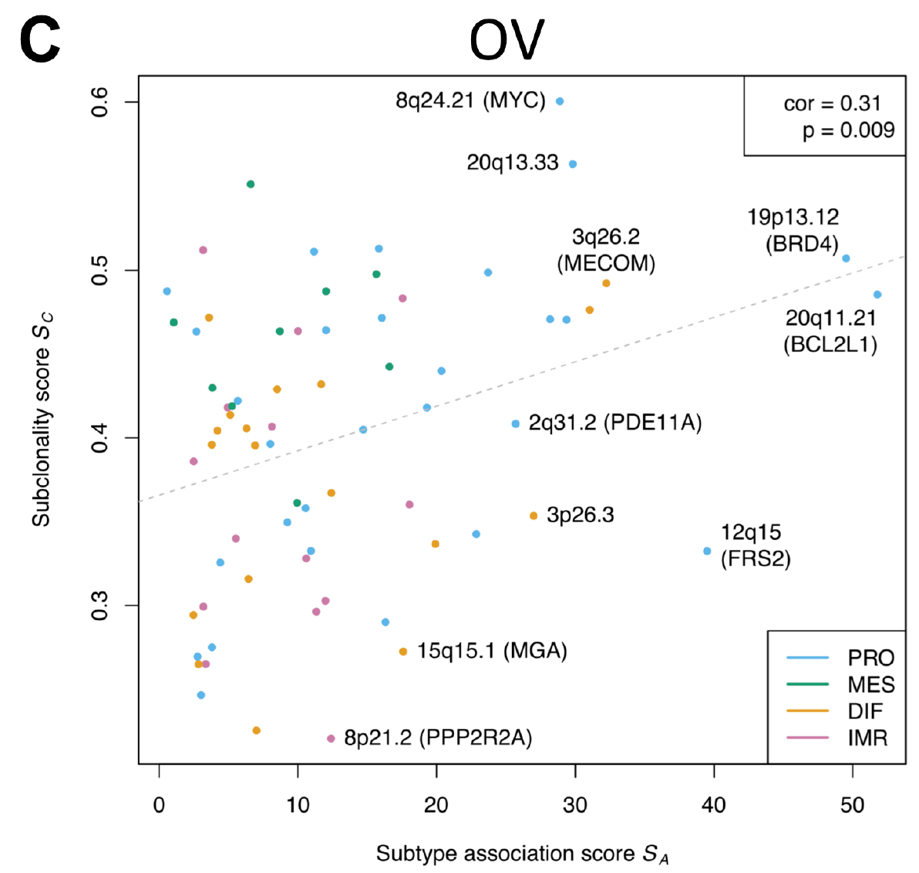
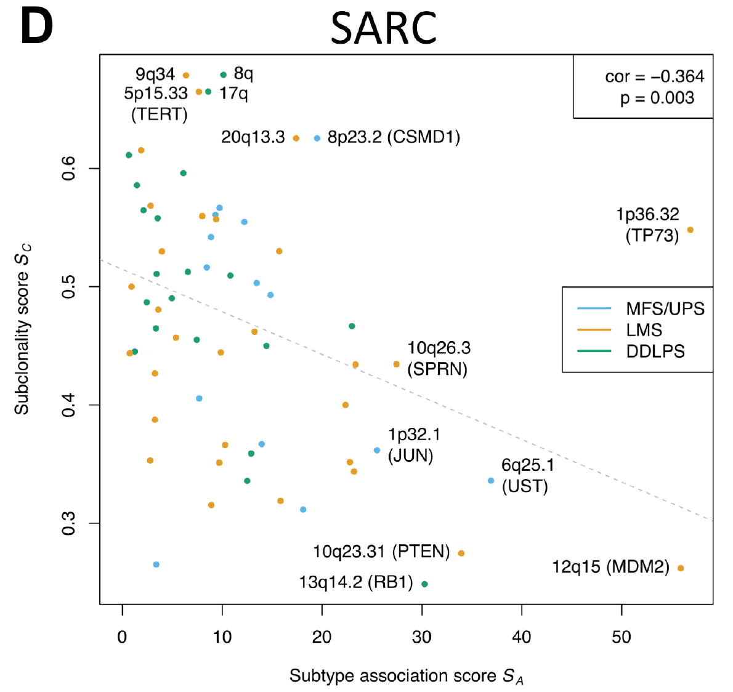
Piece #3: Are subtype-associated focal copy # alterations more, or less, sub-clonal than others?
0.3 0.4 0.5 0.6
Subclonality score S_{C}
Subclonality score S_{C}
0.3 0.4 0.5 0.6
0 10 20 30 40 50
0 10 20 30 40 50
Subtype association score S_{A}
Subtype association score S_{A}

Slide 18
What we’ve learned from bulk RNA + DNA analysis
It is possible to infer subclonality and timing of subtype differentiation from combined RNA + absolute copy number analysis
OVC subtypes do not appear to be “intrinsic”
They appear to be subclonal, and therefore might be more clear at the single-cell level
Bioconductor packages used in preceding analysis: consensusOV, curatedOvarianData, curatedTCGAData, TCGAutils, MultiAssayExperiment, RaggedExperiment, CNVRanger, GenomicRanges

Slide 19
scRNA-seq analysis
1 tumor: Fluidigm deep sequencing of annotated cells
5 tumors: 10X Genomics shallow sequencing
Bioconductor packages used in single-cell analysis: simpleSingleCell workflow, scran, scater, singleR, DropletUtils, consensusOV

Slide 20
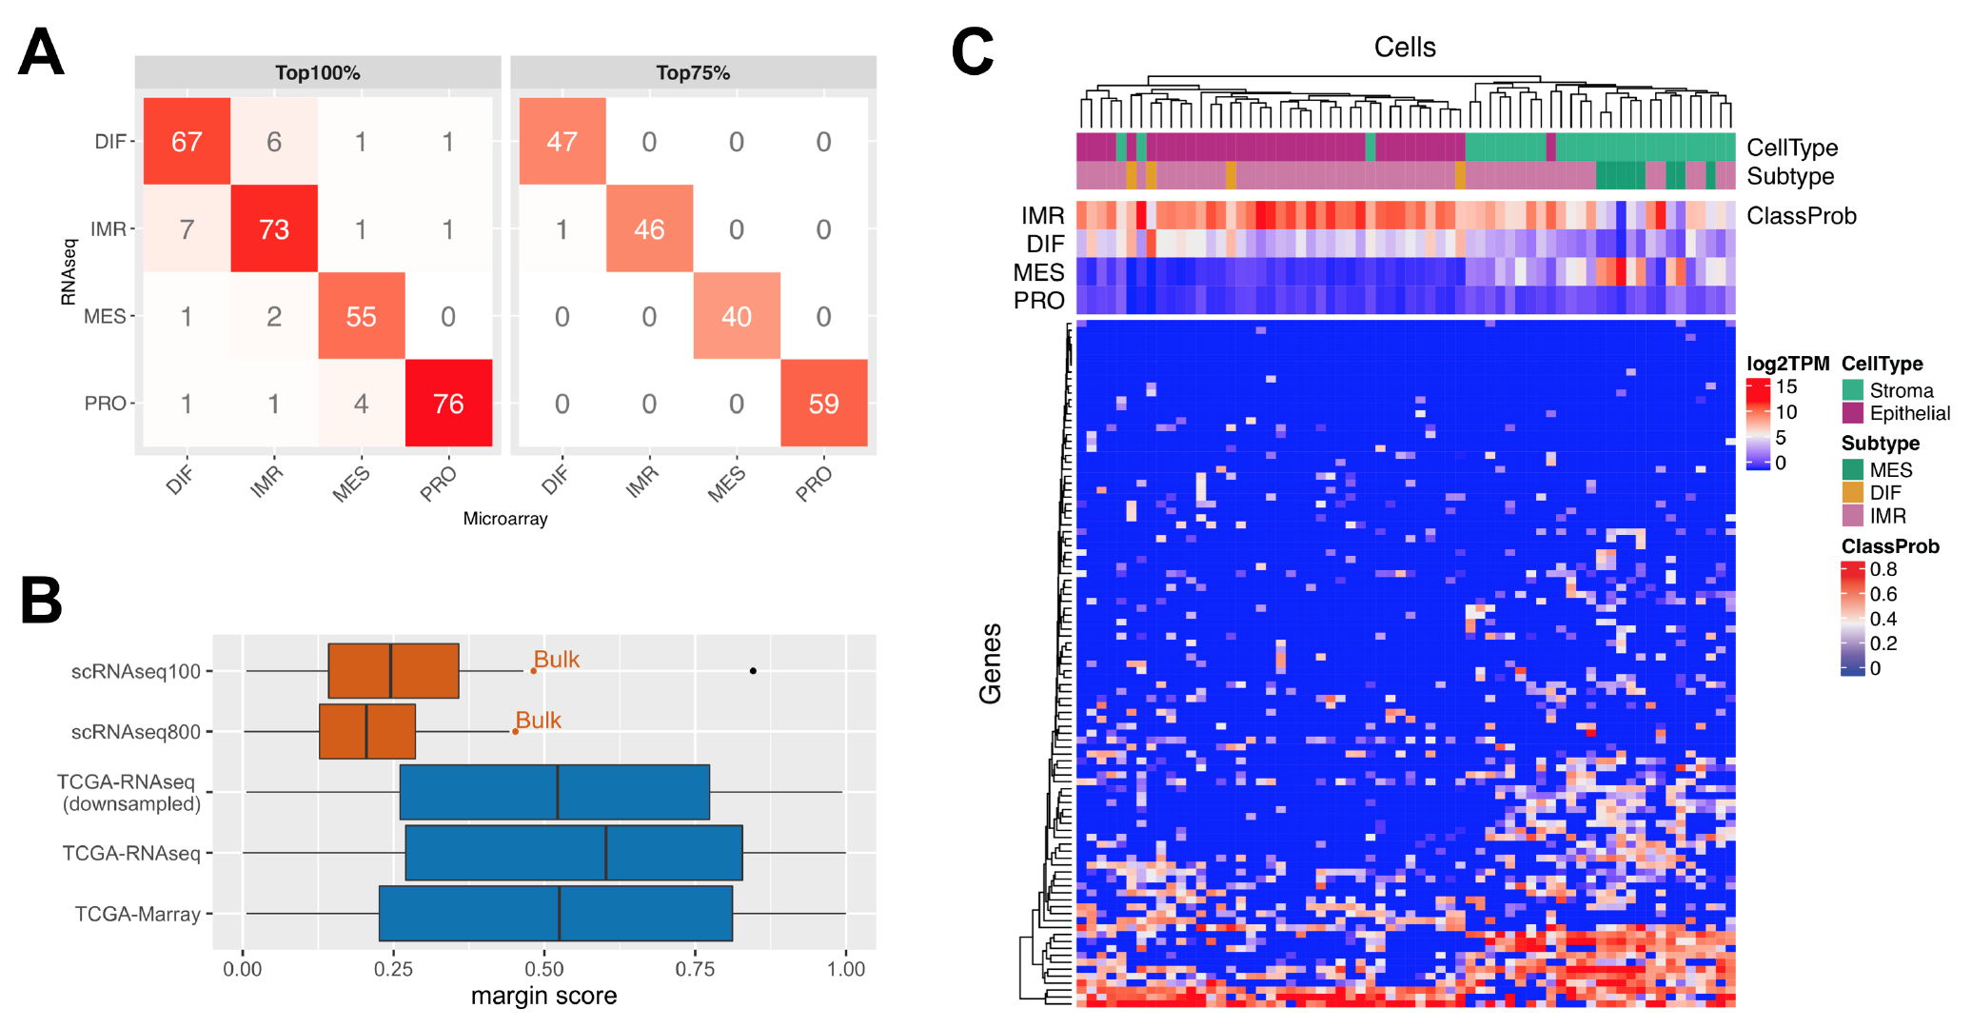
Fluidigm deep scRNA-seq subtyping
Bulk RNA-seq vs microarray
Fluidigm deep scRNA-seq
Bulk RNA-seq vs scRNA-seq
Notes:
Figure 4: Single cell subtyping. (A) shows resulting subtype calls when applying the consensusOV⁸ classifier to TCGA HGS ovarian tumors for which transcriptomic quantification was available via microarray ($x$-axis) and RNA-seq ($y$-axis). Concordance of subtype calls is shown for all tumors (top 100%, left panel) and the top 75% based on margin scores (right panel). The boxplots in (B) show margin score distributions of the subtype classification on 66 single cells (red) from Winterhoff et al.²² as compared to the TCGA bulk classifications (blue) analyzed in (A). Single cell margins are shown when using the default 100-gene signature of the consensus classifier (scRNAseq100, detailed in (C)) and the extended 800-gene signature (scRNAseq800, detailed in Supplementary Figure S7). The margin score of the bulk tumor is indicated in both cases by the red dot. The blue box named TCGA-RNAseq (downsampled) shows the margin score distribution when downsampling TCGA bulk RNA-seq data to match the coverage of the scRNA-seq data. The heatmap in (C) depicts log2 TPM expression values of the 100-gene signature used by the consensus classifier (rows) across 66 cells (columns). The annotation bars at the top show resulting subtype calls (Subtype), previous characterization of cells as epithelial or stromal by Winterhoff et al.²² (CellType), and classification probabilities for each subtype (ClassProb).
Results
Transcriptome subtyping of 66 stromal and epithelial cells
Figure 4C shows subtype calls of the consensus classifier when applied to 66 cells of an HGSOC tumor for which a recent study reported heterogeneity within ovarian cancer epithelium and cancer-associated stromal cells²⁰. The majority of epithelial cells were classified as immunoreactive, in agreement with the classification of the bulk tumor (Probabilities of IMR: 65%, DIF: 16%, MES: 14%, PRO: 5%). Several cells assigned to the stromal group by Winterhoff et al.²⁰ were classified as mesenchymal, consistent with the low purity of mesenchymal tumors (Supplementary Figure S1a) and observations that stromal expression drives classification of mesenchymal tumors³⁸. Classification margin scores, i.e. the difference between the top two subtype scores, were systematically lower for individual cells ($24±15\%$) than for the bulk tumor (48%, Figure 4B). Inspecting subtype classification probabilities of epithelial cells classified as immunoreactive (ClassProb bars in Figure 4C) revealed the differentiated subtype to often closely placing second; and vice versa for the four epithelial cells classified as differentiated. To analyze whether the observed ambiguity in classification of single cells can be explained by zero-inflation of scRNA-seq data, rendering parts of the 100-gene signature of the consensus classifier not informative, we used an extended signature of 800 genes. However, similar subtype calls (Supplementary Figure S7) and margin score distribution (Figure 4B) indicated that the 100-gene signature already captures subtype-specific expression of single cells. In a complementary analysis, we downsampled the TCGA bulk RNA-seq data to match the coverage of the scRNA-seq data. Classification margin scores on the downsampled bulk data resembled the distribution of the original data, and exceeded the margin scores of the scRNA-seq data (Figure 4B).

Slide 21
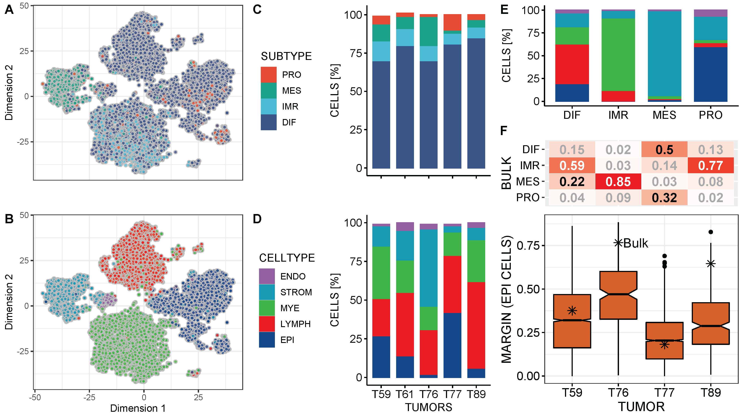
10X Genomics shallow scRNA-seq subtyping from 5 tumors
Notes:
endothelial, stromal, myeloid, lymphocyte, epithelial
Figure 5: Composition of HGS ovarian tumors at single-cell level. (A) and (B) show subtype and cell type assignments for 13,040 individual tumor cells of tumor T59. (C) and (D) show subtype and cell type composition for all five tumors. (E) shows the percentage of cells of a specific cell type (colors as in legend B,D) coinciding with the 4 subtype calls across the 5 tumors. (F) shows subtype classification probabilities for bulk RNA-seq data available for 4 of the 5 tumors (upper panel), and margin score distribution for the epithelial cells of the respective tumor (lower panel). The margin score of the bulk tumor is indicated by an asterisk. Subtype and cell type assignments for individual cells, as in (A) and (B) for tumor T59, are shown for all tumors in Supplementary Figure S8.
Methods: Subtype classification on single cell sequencing data
Bulk and single-cell RNA-seq data for one fresh HGSOC specimen was obtained from the Supplementary Material of Winterhoff et al.²². Subtypes were classified using the consensusOV package⁸. The 800-gene signature was derived by selecting the 200 most representative genes per subtype based on differential expression⁴. TCGA bulk RNA-seq and microarray data were obtained using the curatedTCGAData Bioconductor package. Downsampling of TCGA bulk RNA-seq data to match the coverage of the scRNA-seq data was carried out using the function downsampleMatrix of the DropletUtils package³⁶. Five additional HGSOC specimens were subjected to 10x Genomics single-cell RNA sequencing, producing an average of 235 million reads per patient sample with an average of 11,502 cells/sample and 23,000 reads/cell. Sample collection, experimental procedures, and data processing steps are described in Supplementary Methods S1.
S1.1 Single-cell patient samples
All patient samples were collected using protocols approved by the University of Minnesota’s Institutional
Review Board (Protocol numbers 1408M52905 and 1611M99903). Women were consented to the study
if they had clinical, laboratory and/or imaging findings suspicious for ovarian cancer, including recurrent
ovarian cancer. Women were enrolled upon pathological confirmation of ovarian cancer. Tumor specimens
taken from the operating room were used for clinical diagnoses and excess tissue was released to the study. Samples were kept in media at 4C. Tissue samples were dissected with scalpel and scissors to remove necrotic and fatty tissues and to dice the tumor specimens into small pieces. Tumor pieces were digested at 37C and gentle shaking following the Miltenyi GentleMacs Dissociation system protocol (Miltenyibiotec, San Diego CA). This protocol uses a proprietary mix of enzymes and specially designed centrifuge tubes to generate a single cell suspension. Cells were filtered through a 70 micron filter, washed 2 in PBS and incubated with red blood cell lysis to remove red blood cells. Cell viability was determined based on trypan blue exclusion. Cells were transported to the University of Minnesota core sequencing facility for processing within 3 hours after excision from the patient.
S1.2 Single-cell RNA quantification
RNA was converted to cDNA and tagged with barcodes following the 10x Genomics Single Cell 3’ Protocol
utilizing the ChromiumTM Single Cell 3’ v2 Library & Gel Bead Kit and ChromiumTM Single Cell A
Chip Kit (10X Genomics, Pleasanton, CA). The cDNA was sequenced using an Illumina HiSeq 2500 flow
cell with Rapid chemistry and 100 bp paired end sequencing, producing an average of 235 million reads
per patient sample with an average of 11,502 cells/sample and 23,000 reads/cell. Fastq files were analyzed using CellRanger (v3.0.2) software which performs indexing, demultiplexing, and alignment to produce a matrix of RNA abundance (cells genes) using the Unique Molecular Identifier (UMI) counts. Raw and processed scRNA-seq data is available upon request and will be deposited in GEO upon acceptance.
S1.3 Single-cell data processing
Data preprocessing, quality control (QC), normalization, dimensionality reduction, and clustering was
carried out based on the simpleSingleCell Bioconductor workflow [1], using functionality implemented
in the scater and scran Bioconductor packages [2]. Cells representing outliers for one of three QC
metrics were excluded based on the median absolute deviation (MAD) from the median value of each
metric across all cells. We therefore excluded cells that displayed a high proportion of reads mapped to
mitochondrial genes (3 MADs), small library sizes (1 MAD), and cells with too few expressed genes (1
MAD). For the remaining cells, we excluded genes with an average expression below 0.001, i.e. with less
than 1 read per 1000 cells. Normalization for differences in library size between cells was carried out using
the normalize function from the scater package. Dimensionality reduction was carried out using the
denoisePCA function from the scran package, which carries out principal components analysis (PCA)
and removes principal components corresponding to technical noise. Clustering was carried out using the
buildSNNGraph function from the scran package with the number of nearest neighbors (argument k) set
to 25. The resulting k-nearest-neighbors graph was clustered using the function cluster_walktrap from
the igraph package [3]. Summary statistics of the various processing steps are shown in Supplementary
Table S1.
S1.4 Single-cell annotation
Cell types were annotated based on marker gene expression and similarity to reference transcriptomes
of pure cell types. Marker genes for epithelial, endothelial, lymphoctye, myeloid, and stromal cells were
selected based on the work of Shih et al. [4]. Annotation transfer based on transcriptome similarity to
pure cell types were carried out using the SingleR Bioconductor package [5] with two different reference
databases: (i) The Human Cell Atlas [6], and (ii) a compilation of cell type transcriptomes from
ENCODE [7] and BLUEPRINT [8].

Slide 22
Overall messages
No clear “subtypes” in single cells or bulk tumors
Very helpful cell annotation with SingleR using:
Human Primary Cell Atlas (HPCA), and
Blueprint ENCODE
Trajectory analysis (slingshot, monocle, RNA velocity) identified some known transitions
e.g. Monocyte -> Macrophage
A ”Subtypes spectrum” explained by:
Increasing mutational burden with patient age
Composition of stroma and immune cells
Geistlinger et al. Multi-omic analysis supports a developmental hierarchy of molecular subtypes in high-grade serous ovarian carcinoma. Submitted. https://www.biorxiv.org/content/10.1101/554394v2
Oh et al. Reliable analysis of clinical tumor-only whole exome sequencing data. JCO Clinical Cancer Investigation (In Press). https://www.biorxiv.org/content/10.1101/552711v2

Slide 23
Reliable analysis of clinical tumor-only whole-exome sequencing
Benchmarking ovarian and lung in TCGA
Purity, ploidy
Allele-specific copy number, CN heterogeneity
variant classification, tumor mutational burden (TMB), mutational signatures
Comparison of SNP array vs whole-exome sequencing
With and without matched normal specimens
Oh et al. Reliable analysis of clinical tumor-only whole exome sequencing data. JCO Clinical Cancer Investigation (In Press). https://www.biorxiv.org/content/10.1101/552711v2
Notes:
Using the ovarian carcinoma (OV) and lung adenocarcinoma (LUAD) datasets of The Cancer Genome Atlas (TCGA), which represent opposing extremes with respect to tumor purity, copy number heterogeneity and TMB, we demonstrate high reliability of tumor-only analyses for inference of allele-specific copy number, identification of functional mutations, LOH, mutational signatures, and TMB.

Slide 24
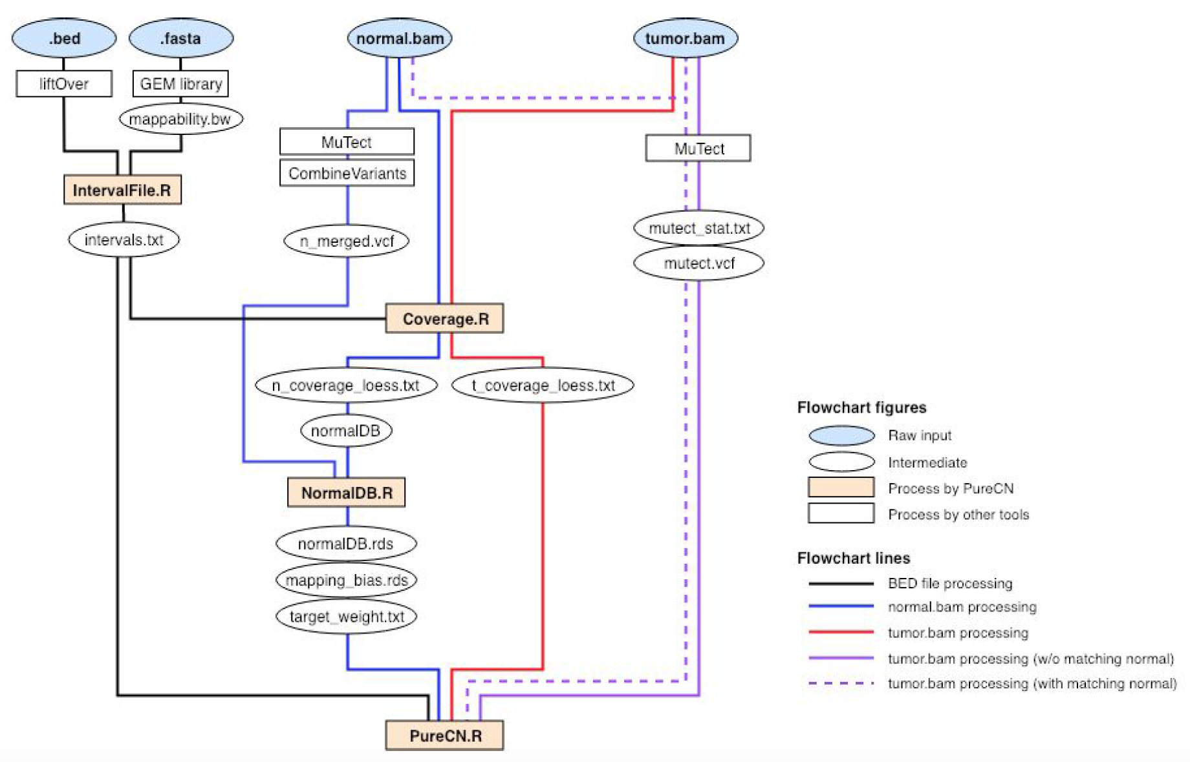
Reliable analysis of clinical tumor-only whole-exome sequencing
Pipeline is complex but Cloud implementation helps
Notes:
GATK, Bioconductor

Slide 25
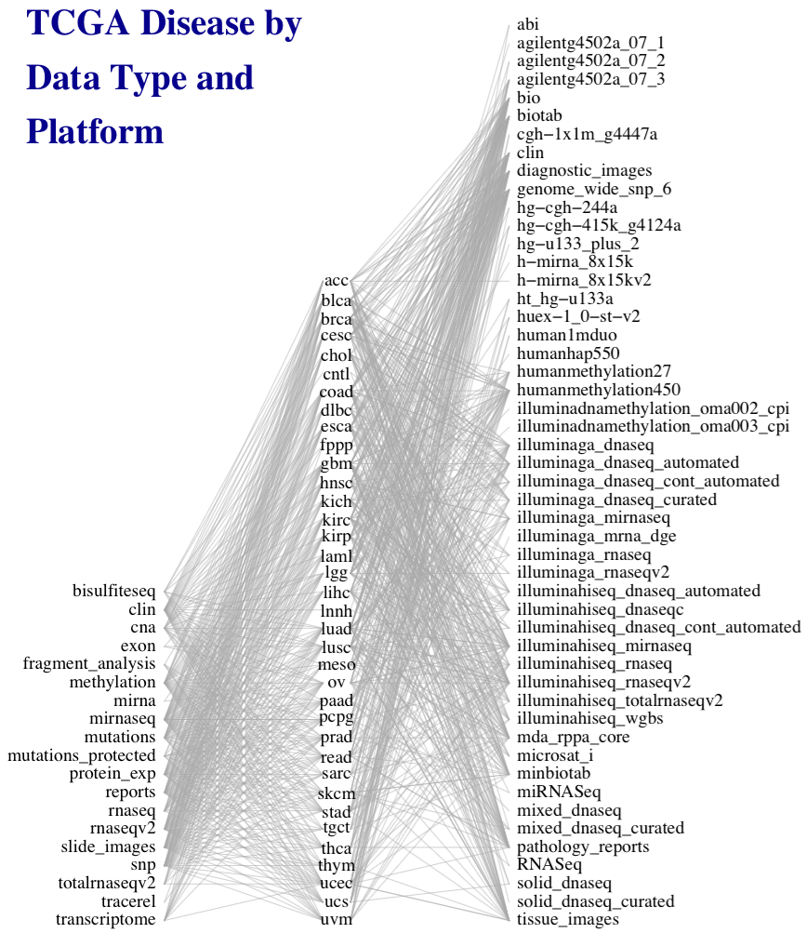
Managing complex data
50 platforms
e.g. TCGA
33 diseases
19 data types
Marcel Ramos
Ramos M et al.: Software for the Integration of Multiomics Experiments in Bioconductor. Cancer Res. 2017, 77:e39–e42.
Ramos M et al. Multi-omic integration of public oncology databases in Bioconductor. Submitted.
Notes:
This work was motivated by the need to simplify general statistical analysis and development of bioinformatic tools for a study as complex as the Cancer Genome Atlas, where 33 cancers were assayed on many platforms to generate different types of data, but also to provide a simplified framework for more easily reproducible and less error-prone analysis of simpler experiments involving just a couple of complementary assays and clinical data.

Slide 26
The role of MultiAssayExperiment
A Bioconductor data structure to:
harmonize single-assay data structures
relate multiple assays with one set of clinical data
handle missing and replicate observations
accommodate ID-based and range-based data
support on-disk representations of big data
Ramos M et al.: Software for the Integration of Multiomics Experiments in Bioconductor. Cancer Res. 2017, 77:e39–e42.
Ramos M et al. Multi-omic integration of public oncology databases in Bioconductor. Submitted.
Notes:
A core data structure was needed to
* harmonize existing structures for different types of data,
* relate assays with each other and clinical data
* handle the reality that such experiments are often incomplete and missing observations on some assays, and also may contain replicates, time series, or matched normal,
* accommodate data that are indexed by IDs such as genes and data indexed by genomic ranges,
* and support on-disk representations for big data

Slide 27
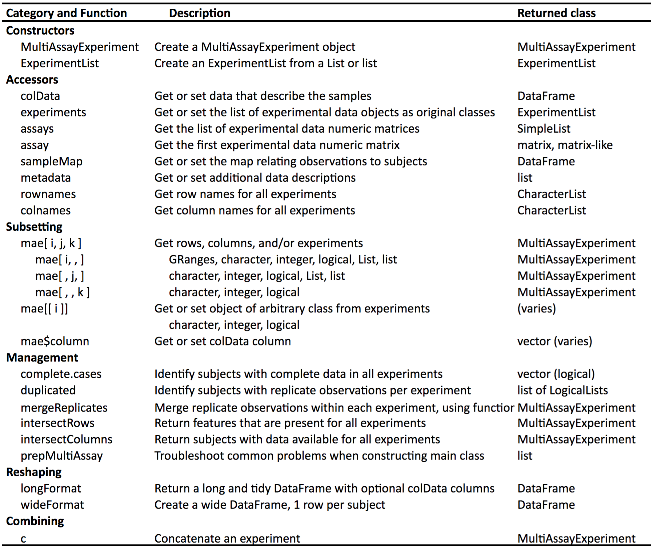
The MultiAssayExperiment API
Notes:
To help those wanting to analyze TCGA data, we’ve constructed MultiAssayExperiments for 33 cancer types. Each cancer type is represented by a single object containing all the most commonly used, unrestricted data. These objects are immediately usable, even on most laptops, with the API shown on the previous page.

Slide 28
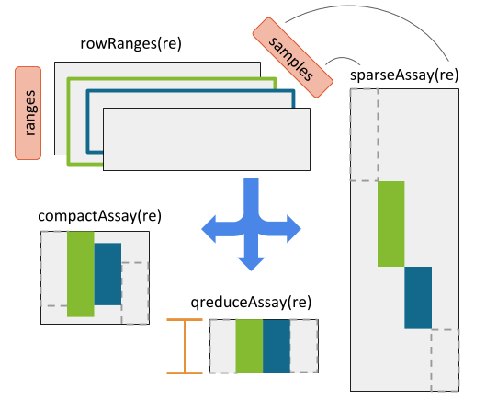
RaggedExperiment (segmented copy number, mutations)
Authors:
Marcel Ramos
Martin Morgan
http://bioconductor.org/packages/RaggedExperiment

Slide 29
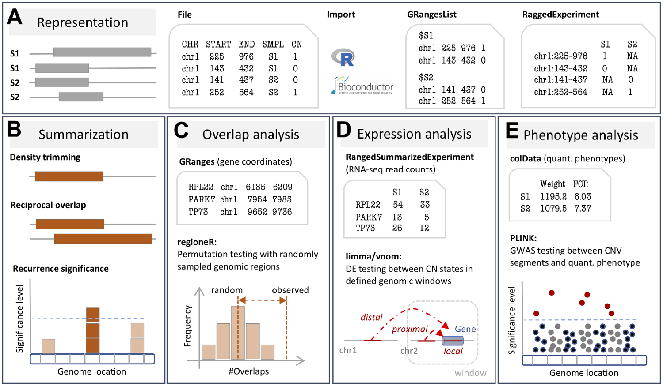
CNVRanger: association analysis of CNVs with gene expression and quantitative phenotypes
Notes:
Fig. 1. (A) The CNVRanger package imports CNV calls from a simple file format into R, and stores them in dedicated Bioconductor data structures, and (B) implements three frequently used approaches for summarizing CNV calls across a population: (i) the CNVRuler procedure that trims region margins based on regional density (Kim et al., 2012), (ii) the RO procedure that requires sufficient mutual overlap between calls (Conrad et al., 2010), and (iii) the GISTIC procedure that identifies recurrent CNV regions (Beroukhim et al., 2007). (C)CNVRanger builds on regioneR (Gel et al., 2015) for overlap analysis of CNVs with functional genomic regions, (D) implements RNA-seq expression Quantitative Trait Loci analysis for CNVs by interfacing with edgeR (Robinson et al., 2010), and (E) interfaces with PLINK (Purcell et al., 2007) for traditional genome-wide association studies (GWAS) between CNVs and quantitative phenotypes
Unless provided in the caption above, the following copyright applies to the content of this slide: © The Author(s) 2019. Published by Oxford University Press.This is an Open Access article distributed under the terms of the Creative Commons Attribution License (http://creativecommons.org/licenses/by/4.0/), which permits unrestricted reuse, distribution, and reproduction in any medium, provided the original work is properly cited.

Slide 30
curatedTCGAData
> acc <- curatedTCGAData(diseaseCode = "ACC", assays="*", dry.run = FALSE)
> acc
A MultiAssayExperiment object of 9 listed
experiments with user-defined names and respective classes.
Containing an ExperimentList class object of length 9:
[1] ACC_CNASNP-20160128: RaggedExperiment with 79861 rows and 180 columns
[2] ACC_CNVSNP-20160128: RaggedExperiment with 21052 rows and 180 columns
[3] ACC_GISTIC_AllByGene-20160128: SummarizedExperiment with 24776 rows and 90 col$
[4] ACC_GISTIC_ThresholdedByGene-20160128: SummarizedExperiment with 24776 rows an$
[5] ACC_Methylation-20160128: SummarizedExperiment with 485577 rows and 80 columns
[6] ACC_miRNASeqGene-20160128: SummarizedExperiment with 1046 rows and 80 columns
[7] ACC_Mutation-20160128: RaggedExperiment with 20166 rows and 90 columns
[8] ACC_RNASeq2GeneNorm-20160128: SummarizedExperiment with 20501 rows and 79 colu$
[9] ACC_RPPAArray-20160128: SummarizedExperiment with 192 rows and 46 columns
Features:
experiments() - obtain the ExperimentList instance
colData() - the primary/phenotype DataFrame
sampleMap() - the sample availability DataFrame
`$`, `[`, `[[` - extract colData columns, subset, or experiment
*Format() - convert into a long or wide DataFrame
assays() - convert ExperimentList to a SimpleList of matrices
> browseVignettes(package=“TCGAutils”)
> acc <- curatedTCGAData(diseaseCode = "ACC", assays="*", dry.run = FALSE)
> acc
A MultiAssayExperiment object of 9 listed
experiments with user-defined names and respective classes.
Containing an ExperimentList class object of length 9:
[1] ACC_CNASNP-20160128: RaggedExperiment with 79861 rows and 180 columns
[2] ACC_CNVSNP-20160128: RaggedExperiment with 21052 rows and 180 columns
[3] ACC_GISTIC_AllByGene-20160128: SummarizedExperiment with 24776 rows and 90 col$
[4] ACC_GISTIC_ThresholdedByGene-20160128: SummarizedExperiment with 24776 rows an$
[5] ACC_Methylation-20160128: SummarizedExperiment with 485577 rows and 80 columns
[6] ACC_miRNASeqGene-20160128: SummarizedExperiment with 1046 rows and 80 columns
[7] ACC_Mutation-20160128: RaggedExperiment with 20166 rows and 90 columns
[8] ACC_RNASeq2GeneNorm-20160128: SummarizedExperiment with 20501 rows and 79 colu$
[9] ACC_RPPAArray-20160128: SummarizedExperiment with 192 rows and 46 columns
Features:
experiments() - obtain the ExperimentList instance
colData() - the primary/phenotype DataFrame
sampleMap() - the sample availability DataFrame
`$`, `[`, `[[` - extract colData columns, subset, or experiment
*Format() - convert into a long or wide DataFrame
assays() - convert ExperimentList to a SimpleList of matrices
> browseVignettes(package=“TCGAutils”)
Ramos M et al. Multi-omic integration of public oncology databases in Bioconductor. Submitted.

Slide 31
Ongoing work: analyst-friendly data
curatedOvarianData
30 datasets, most annotated for OS, surgical debulking, histology
curatedCRCData
34 datasets, many annotated for MSS, gender, stage, age, N, M
curatedBladderData
12 datasets, many annotated for stage, grade, OS
curatedTCGAData + TCGAutils
The Cancer Genome Atlas as MultiAssayExperiment
cBioPortalData (still GitHub.com/waldronlab)
150+ multi’omics cancer datasets as MultiAssayExperiment
HMP16SData
Simple access to The Human Microbiome Project
curatedMetagenomicData
57 datasets of microbiome abundance and metabolic function
most annotated for age, BMI, sex, disease
Includes the Human Microbiome Project
https://waldronlab.io/publications

Slide 32

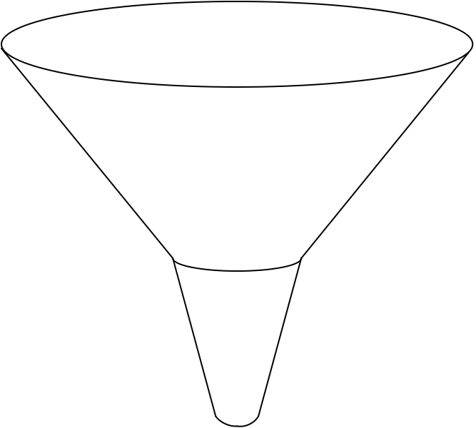
curatedMetagenomicData pipeline
Raw
fastq files
13 datasets
2,875 samples
Study metadata
Age, body site, disease, etc…
Lucas Schiffer
PhD candidate
57 datasets
10,199 samples
Convenience download functions
Megabytes-sized datasets
Download (~25TB)
ExperimentHub product
Amazon S3 cloud distribution
Tag-based searching
Dataset snapshot dates
Automatic local caching
Uniform processing
Manual curation
MetaPhlAn2
HUMAnN2
Automatic documentation
species abundance
metabolic pathway abundance
Integrated Bioconductor ExpressionSet objects
Per-patient microbiome data
Per-patient metadata
Experiment-wide metadata
marker
presence
metabolic pathway presence
standardized metadata
marker abundance
gene family abundance
Integration
High computational load pipeline
> 60 kH CPU, 75TB disk requirements
Pasolli E, Schiffer L, et al.: Accessible, curated metagenomic data through ExperimentHub. Nat. Methods 2017, 14:1023–1024.
Notes:
https://upload.wikimedia.org/wikipedia/commons/thumb/7/7e/Funnel_Mech.svg/667px-Funnel_Mech.svg.png
https://pixabay.com/en/cheering-happy-jumping-people-297419/

Slide 33
curatedMetagenomicData use
One dataset from R:
> curatedMetagenomicData("HMP_2012.metaphlan_bugs_list.stool”)
Many datasets from R:
> curatedMetagenomicData("HMP_2012.metaphlan_bugs_list.*”)
Command-line:
$ curatedMetagenomicData -p "HMP_2012.metaphlan_bugs_list.*"
Pasolli E, Schiffer L, et al.: Accessible, curated metagenomic data through ExperimentHub. Nat. Methods 2017, 14:1023–1024.

Slide 34
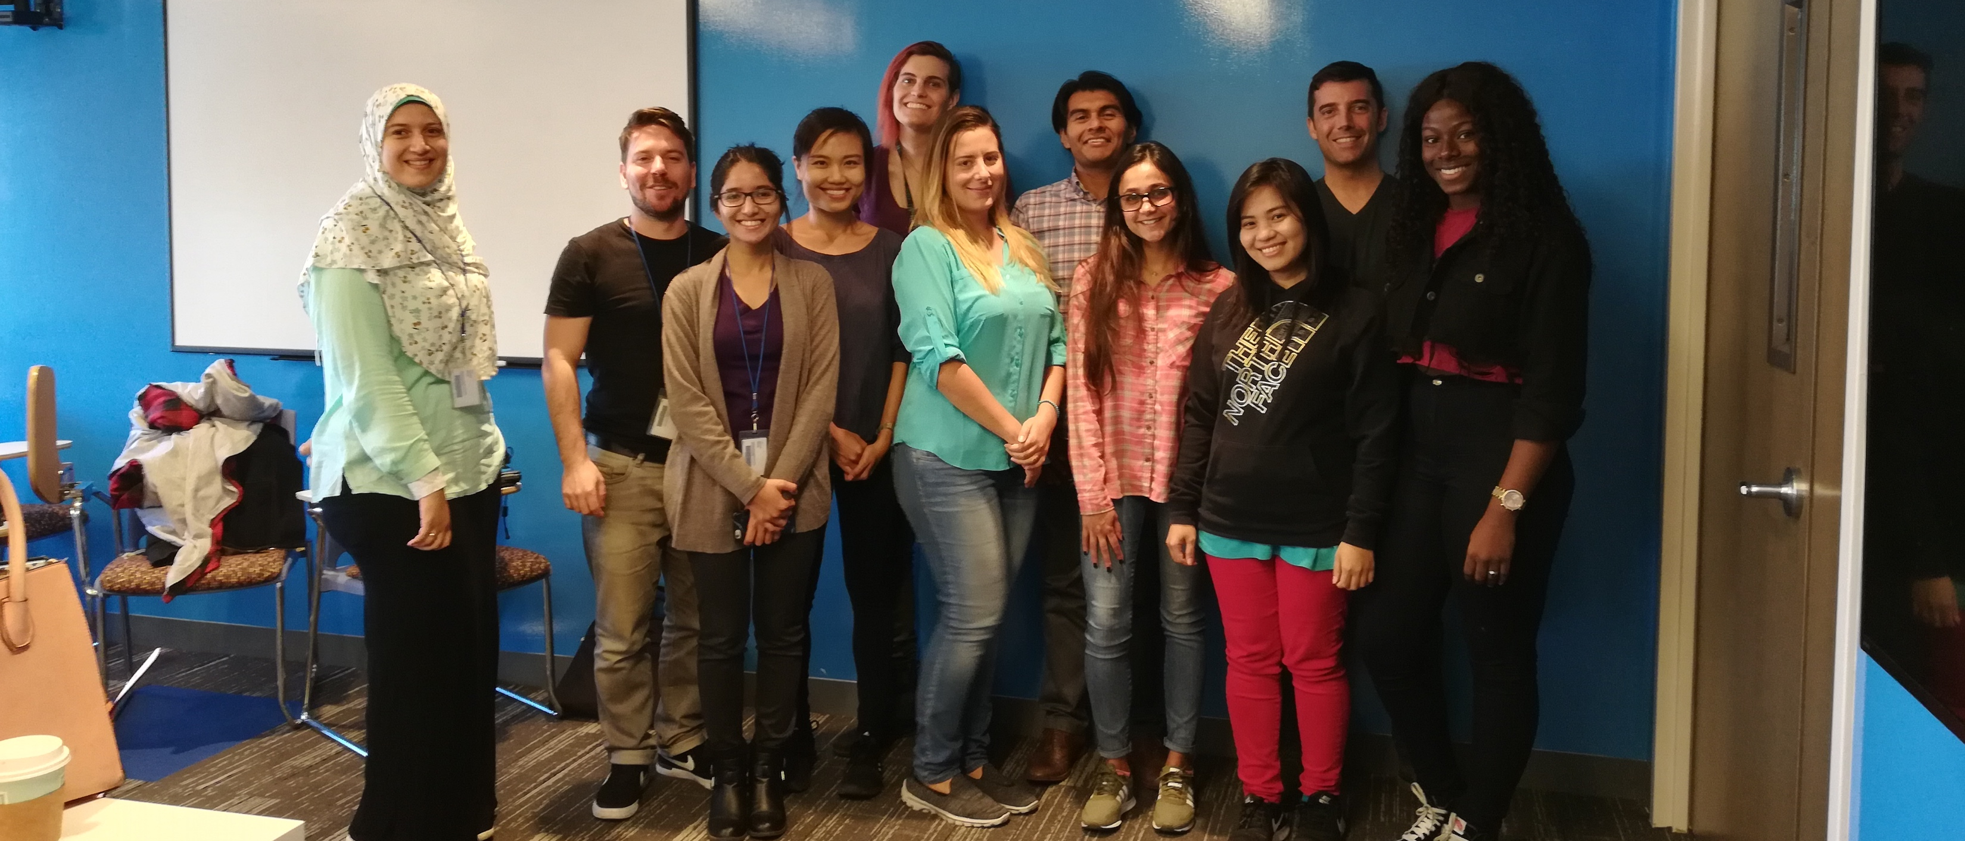
Thank you
waldronlab.io
Post-docs: Ludwig Geistlinger, Sehyun Oh, Kelly Eckenrode
Developer: Marcel Ramos
PhD student: Chloe Mirzayi
MPH students: Asya Khleborodova, Kelly Jack, Yaseen Javaid, Utsav Patel
Research assistants and interns: Shaimaa Elsafoury, Rimsha Azhar, Fatima Zohra, Utsav Patel, Valentina Pineda
Collaborators:
Bioconductor: Martin Morgan, Vincent Carey, Davide Risso
Tim Starr, University of Minnesota
Notes:
met Jin Xu from East China Normal University, Shanghai

Slide 35
GSE12418 with subtype calls

Slide 36
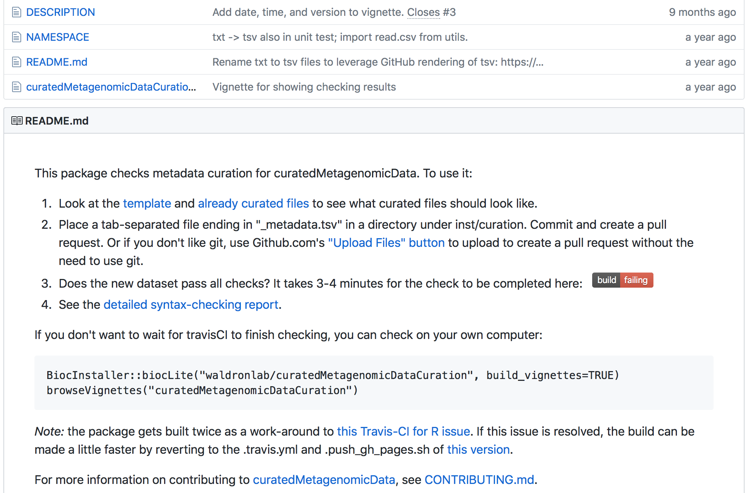
Formalizing curation
Pasolli E et al.: Accessible, curated metagenomic data through ExperimentHub. Nat. Methods 2017, 14:1023–1024.

Slide 37
A reproducible, replicable classifier for high-grade serous ovarian carcinoma
Based on consensus of three published subtyping efforts of HGSOC
Originally defined to classify every tumor – poor robustness and concordance
Modified to predict probabilities of each subtype, and allow leaving ambiguous tumors unclassified
16 datasets from curatedMetagenomicData
Chen et al: Consensus on Molecular Subtypes of High-grade Serous Ovarian Carcinoma. Clin. Cancer Res. 2018:clincanres.0784.2018.

Slide 38
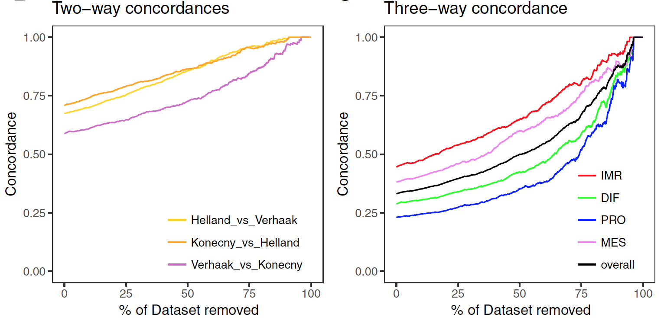
Most tumors are not well-classifiable

Slide 39
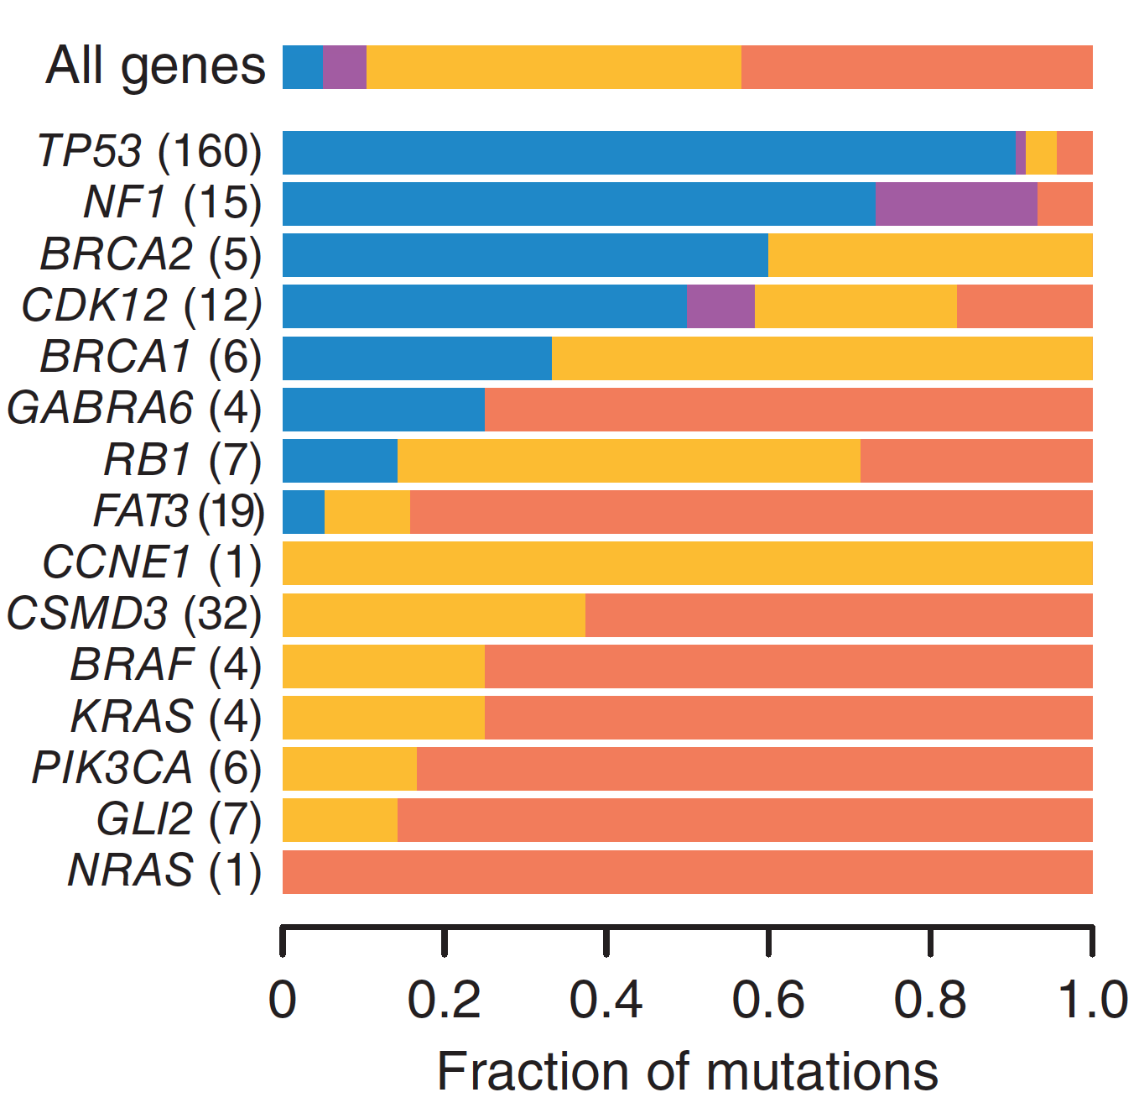
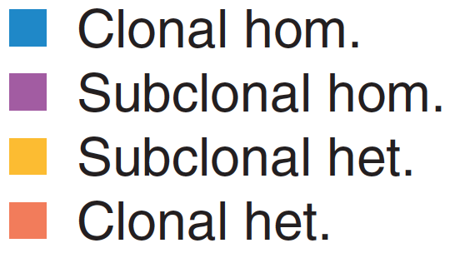
Somatic mutations are subclonal
Classification of somatic mutations in 214 primary HGSOC tumors from TCGA
Carter SL et al.: Absolute quantification of somatic DNA alterations in human cancer. Nat. Biotechnol. 2012, 30:413–421.

Slide 40
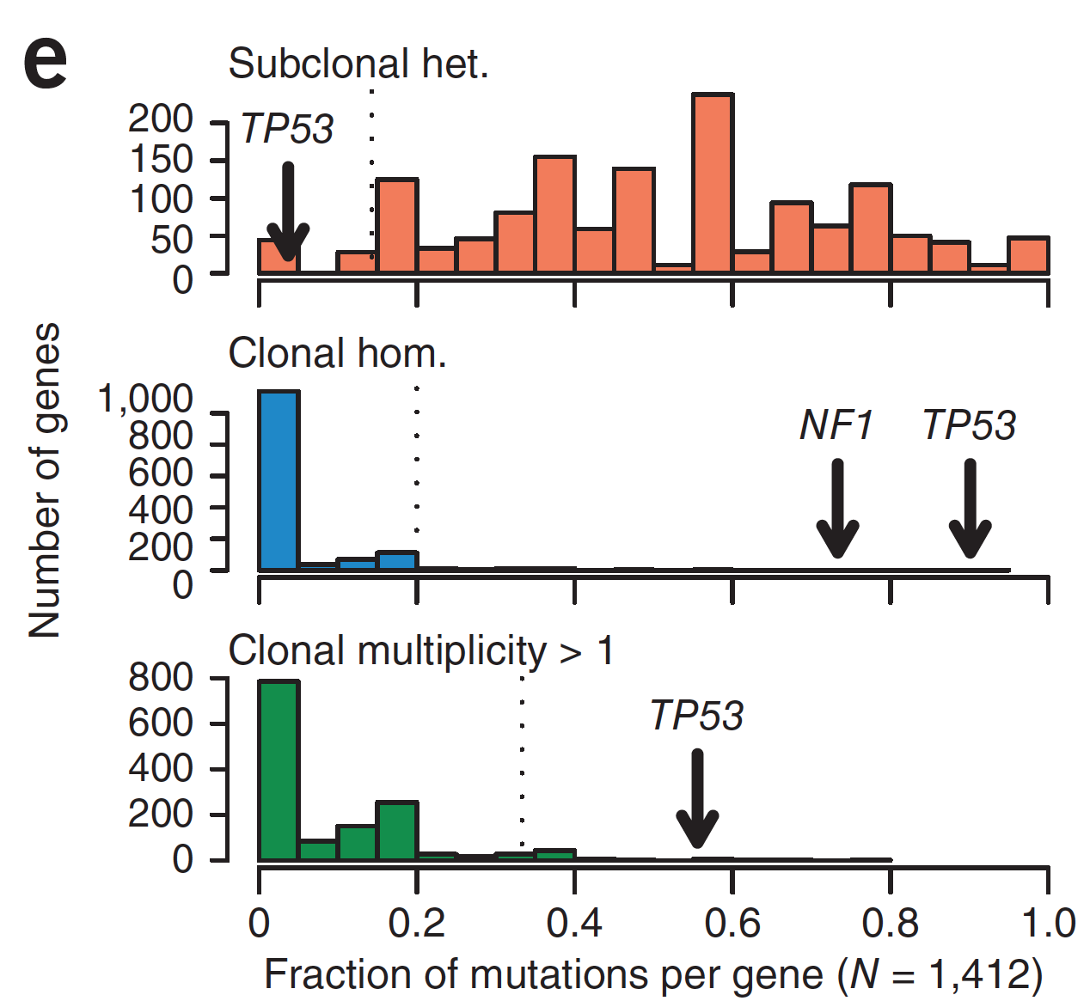
OVC somatic mutations are subclonal
Carter SL et al.: Absolute quantification of somatic DNA alterations in human cancer. Nat. Biotechnol. 2012, 30:413–421.

Slide 41
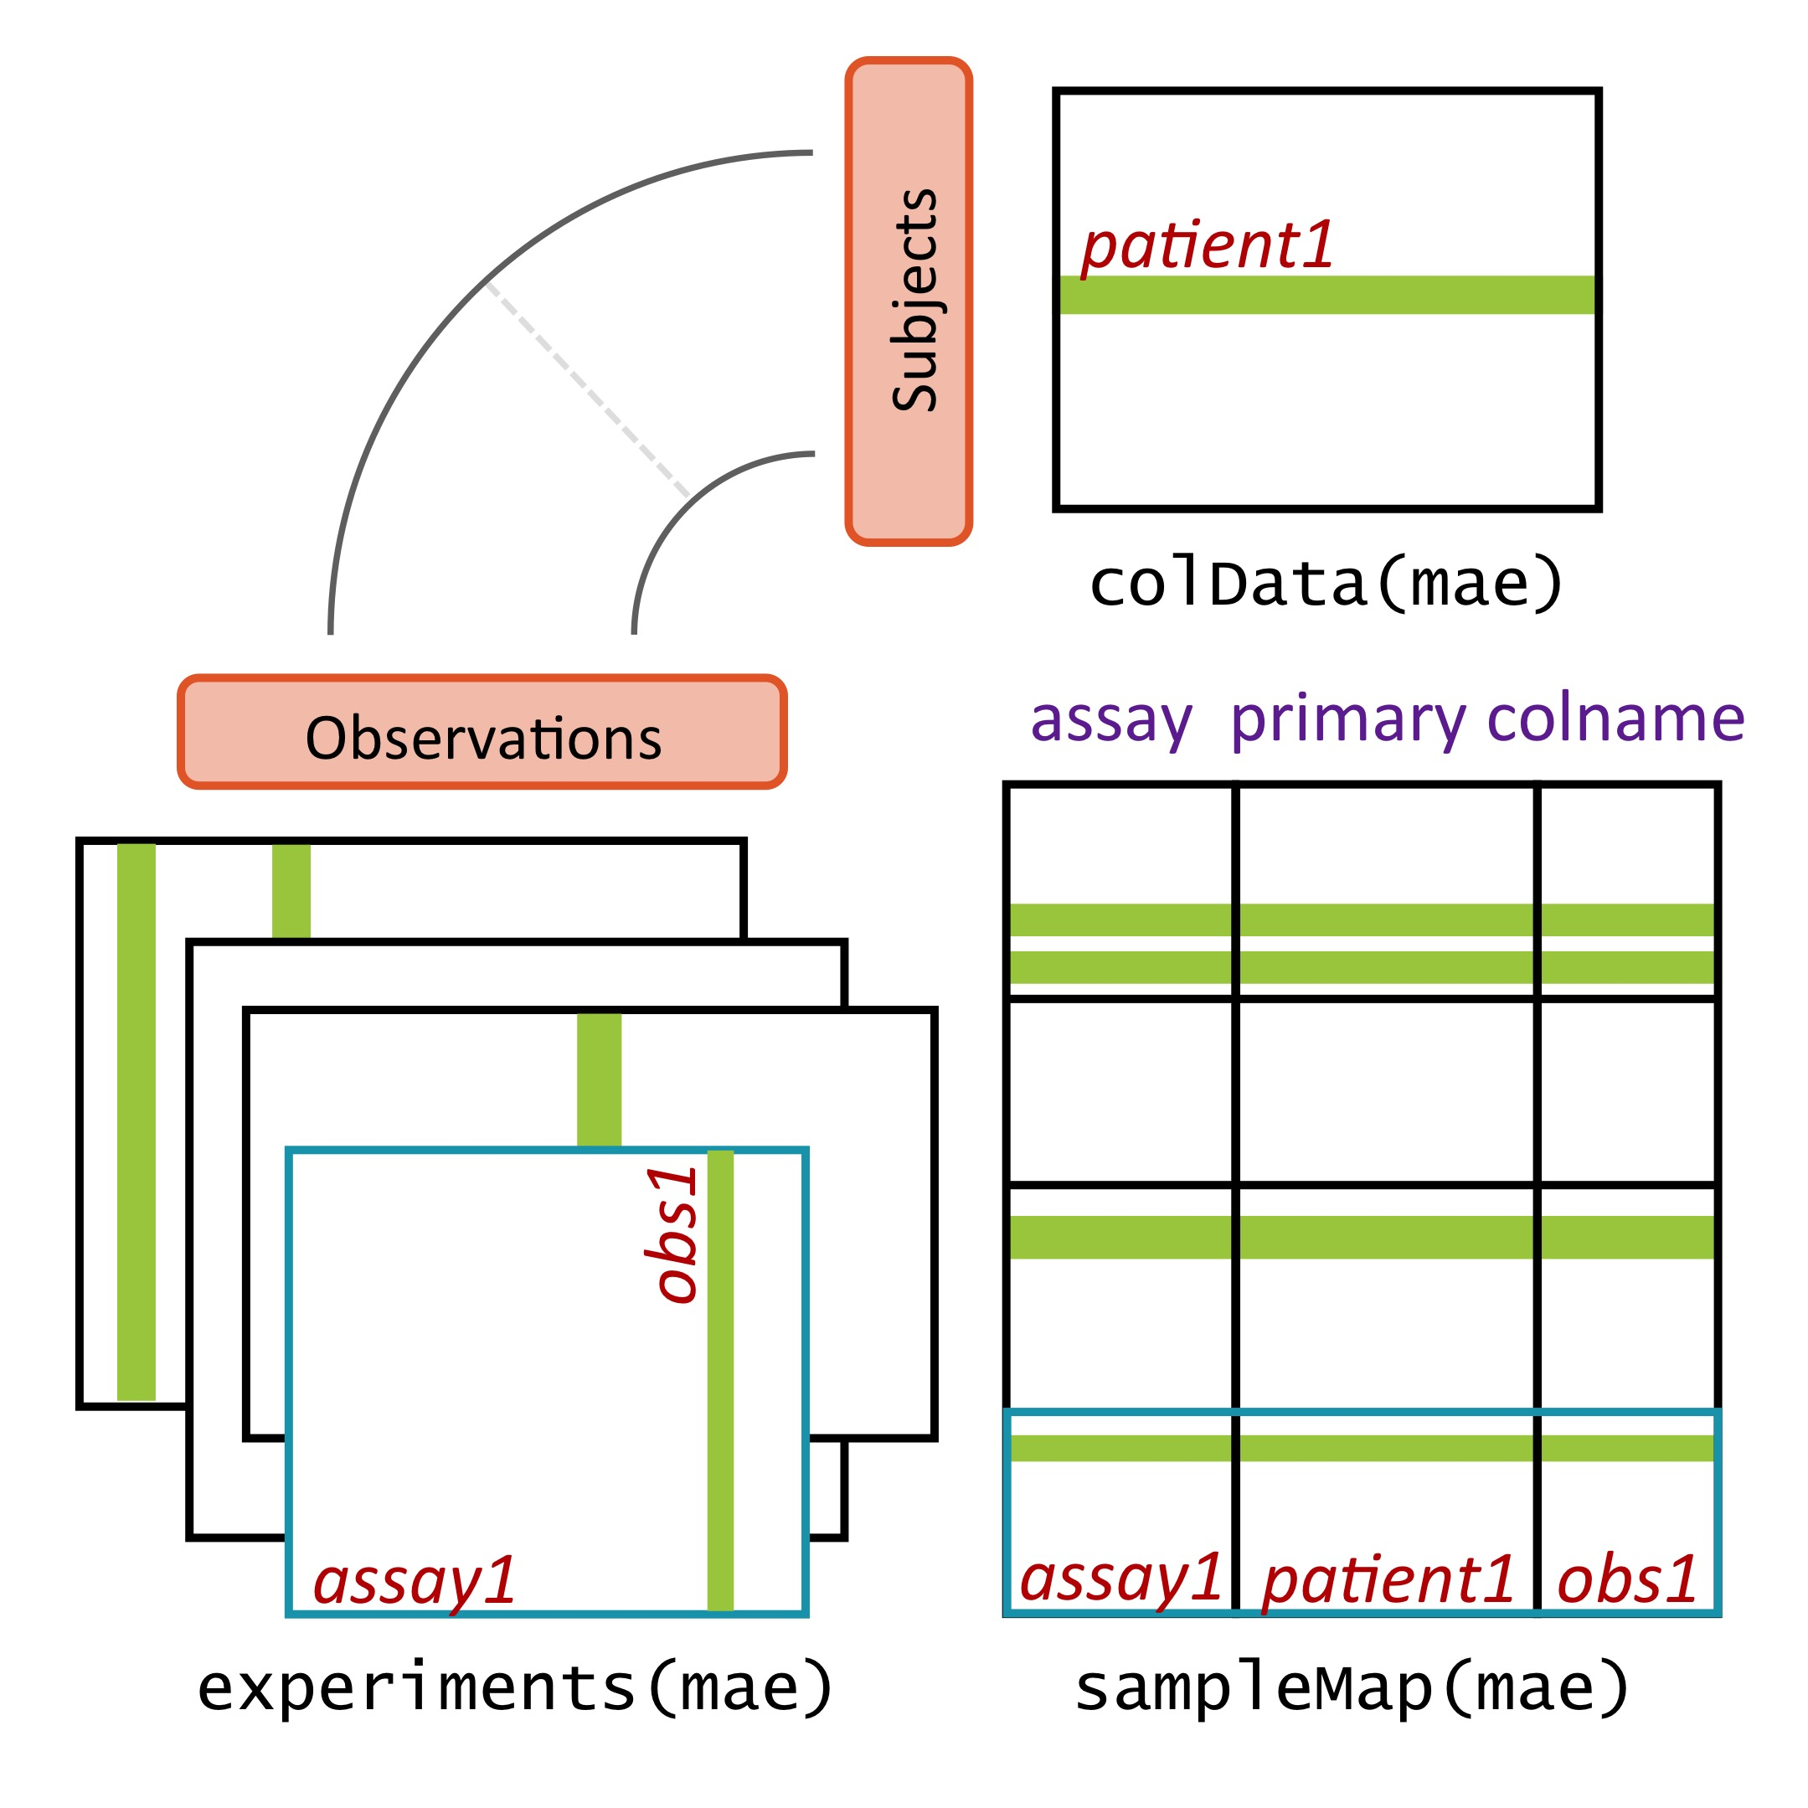
MultiAssayExperiment design
Figure Credit: Marcel Ramos
Ramos M et al.: Software for the Integration of Multiomics Experiments in Bioconductor. Cancer Res. 2017, 77:e39–e42.
Notes:
MultiAssayExperiment addresses these challenges by relating a table of information about subjects, say clinical and pathological data, to a series of genomic data sets of arbitrary shape and even non-tabular data, via a map or a network relating these. This sounds complex and it can be, but from the analyst’s perspective, there is an API that will be familiar to users of R, and that abstracts this complexity from the user. Constructing, accessing, subsetting, data management or manipulation, and combining and reshaping into forms usable by standard tools become straightforward.

Slide 42
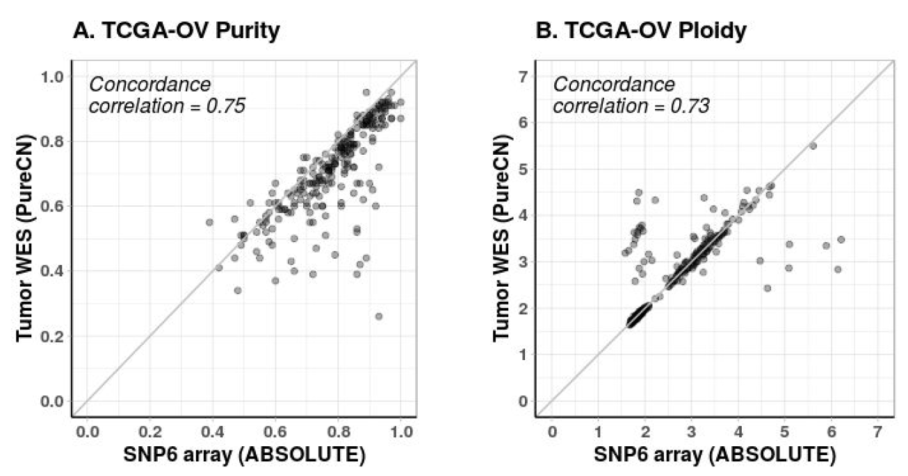
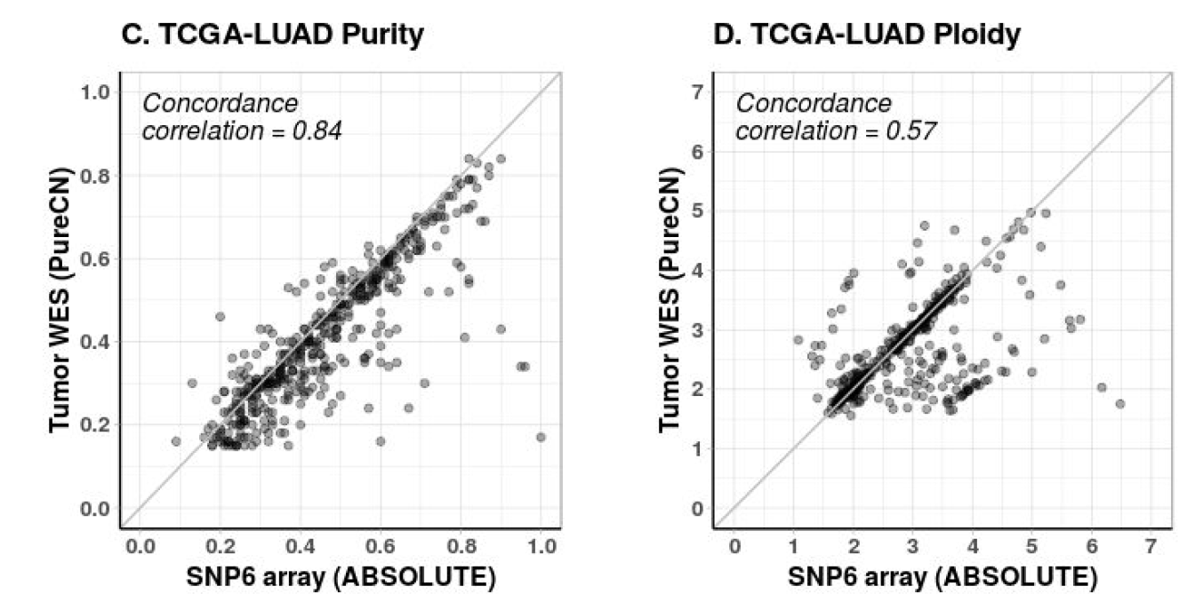
Reliable analysis of clinical tumor-only whole-exome sequencing
Oh et al. Reliable analysis of clinical tumor-only whole exome sequencing data. JCO Clinical Cancer Investigation (In Press). https://www.biorxiv.org/content/10.1101/552711v2

Slide 43
A note on reproducibility, etc.
 |  | Data
 |  | Same | Different
Code | Same | Reproducible | Replicable
 | Different | Robust | Generalizable
Whitaker, Kirstie (2017): Publishing a reproducible paper.
https://doi.org/10.6084/m9.figshare.4720996.v1

